Slide 1
Midline Insertion

Slide 2
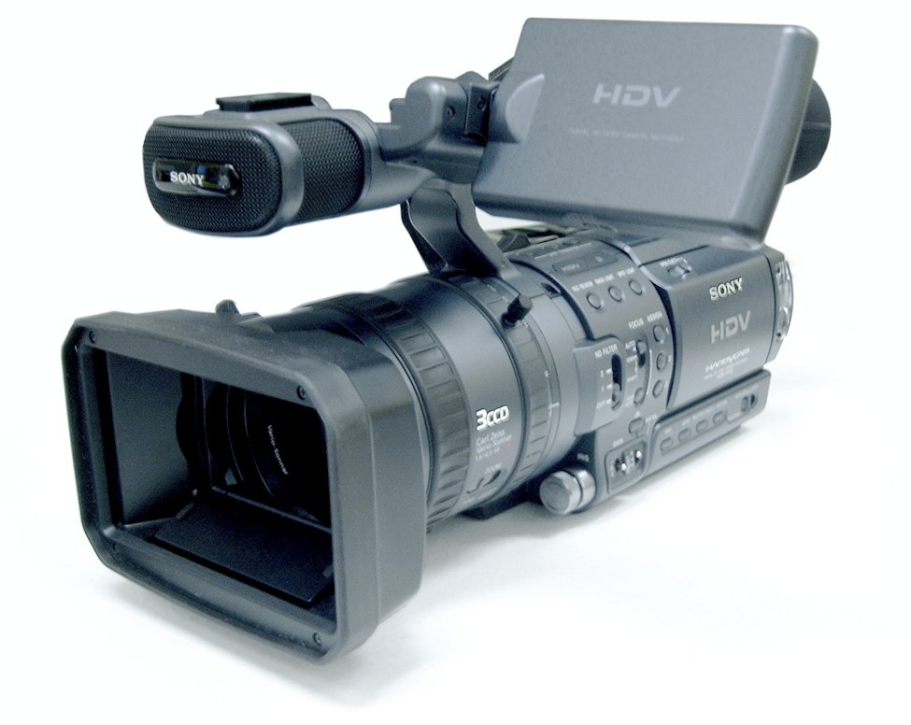
Midline Insertion
To be used with

Slide 3
Midline Insertion
Session Content
Current Practices in IV therapy
Overview of Vascular Access Devices
Device Selection
Overview of Midlines
Insertion techniques

Slide 4
Midline Insertion
Vascular Access
Intravenous (I.V.) therapy has become a vital component in patient care and it is estimated that the majority of patients (80%) admitted to any hospital in the United Kingdom will receive an I.V. device during their hospital stay each year, (Alexandrou 2016).

Slide 5
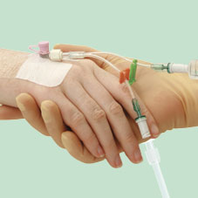
Midline Insertion
Peripheral Vascular Catheter (PVC)
The most commonly used invasive medical device within acute care settings in NHS (Scotland)
Complications include:
Catheter failure (35-50%) Helm, 2015
Phlebitis
CRBSIs
Complications can arise due to:
Poor insertion technique
Poor maintenance
PVC’s are invasive devices and should only be inserted when there are clear clinical indicators.
(Health Protection Scotland, 2014)

Slide 6
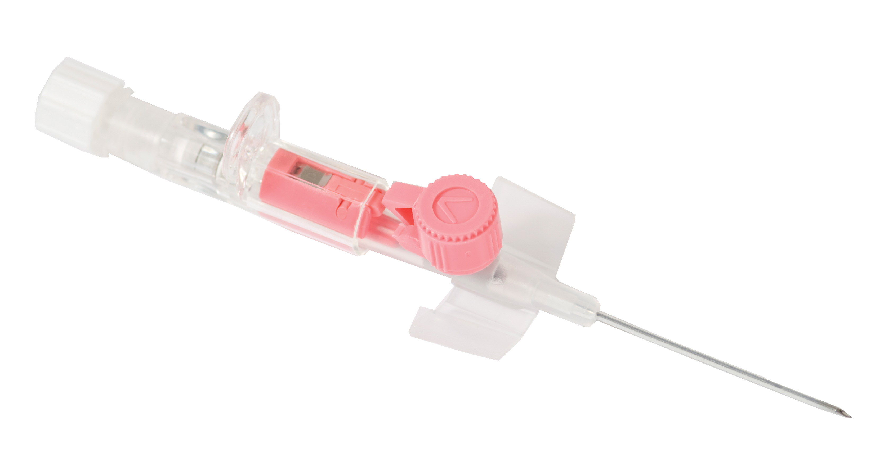
Midline Insertion
Current Practice
Short peripheral IV cannula:
Effects of prolonged IV therapy using peripheral cannula
Effects of repeated prolonged cannulation
Delay in treatment and cost of delayed long term device placement
Vessel health and preservation.

Slide 7
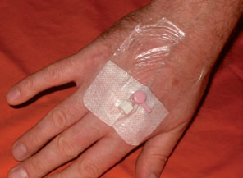
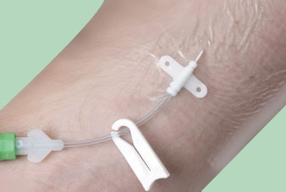
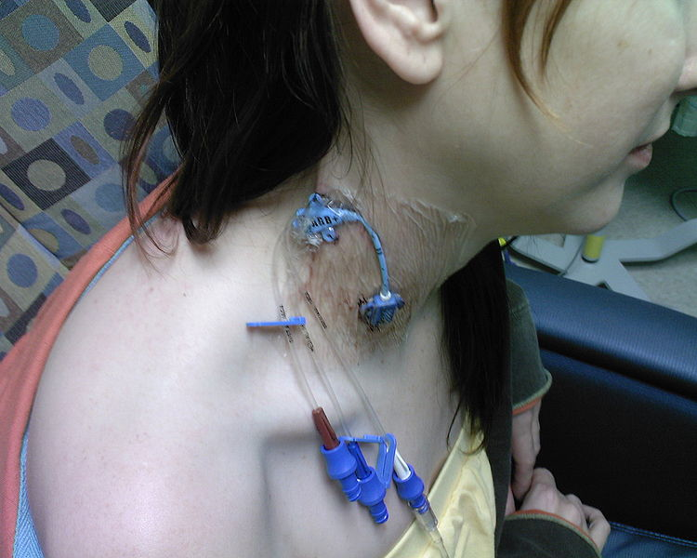
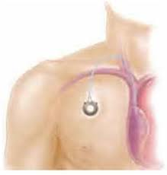
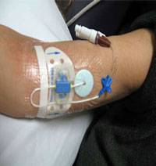
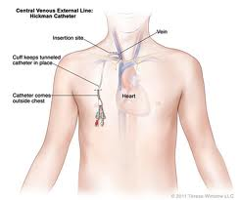
Midline Insertion
Devices Available

Slide 8
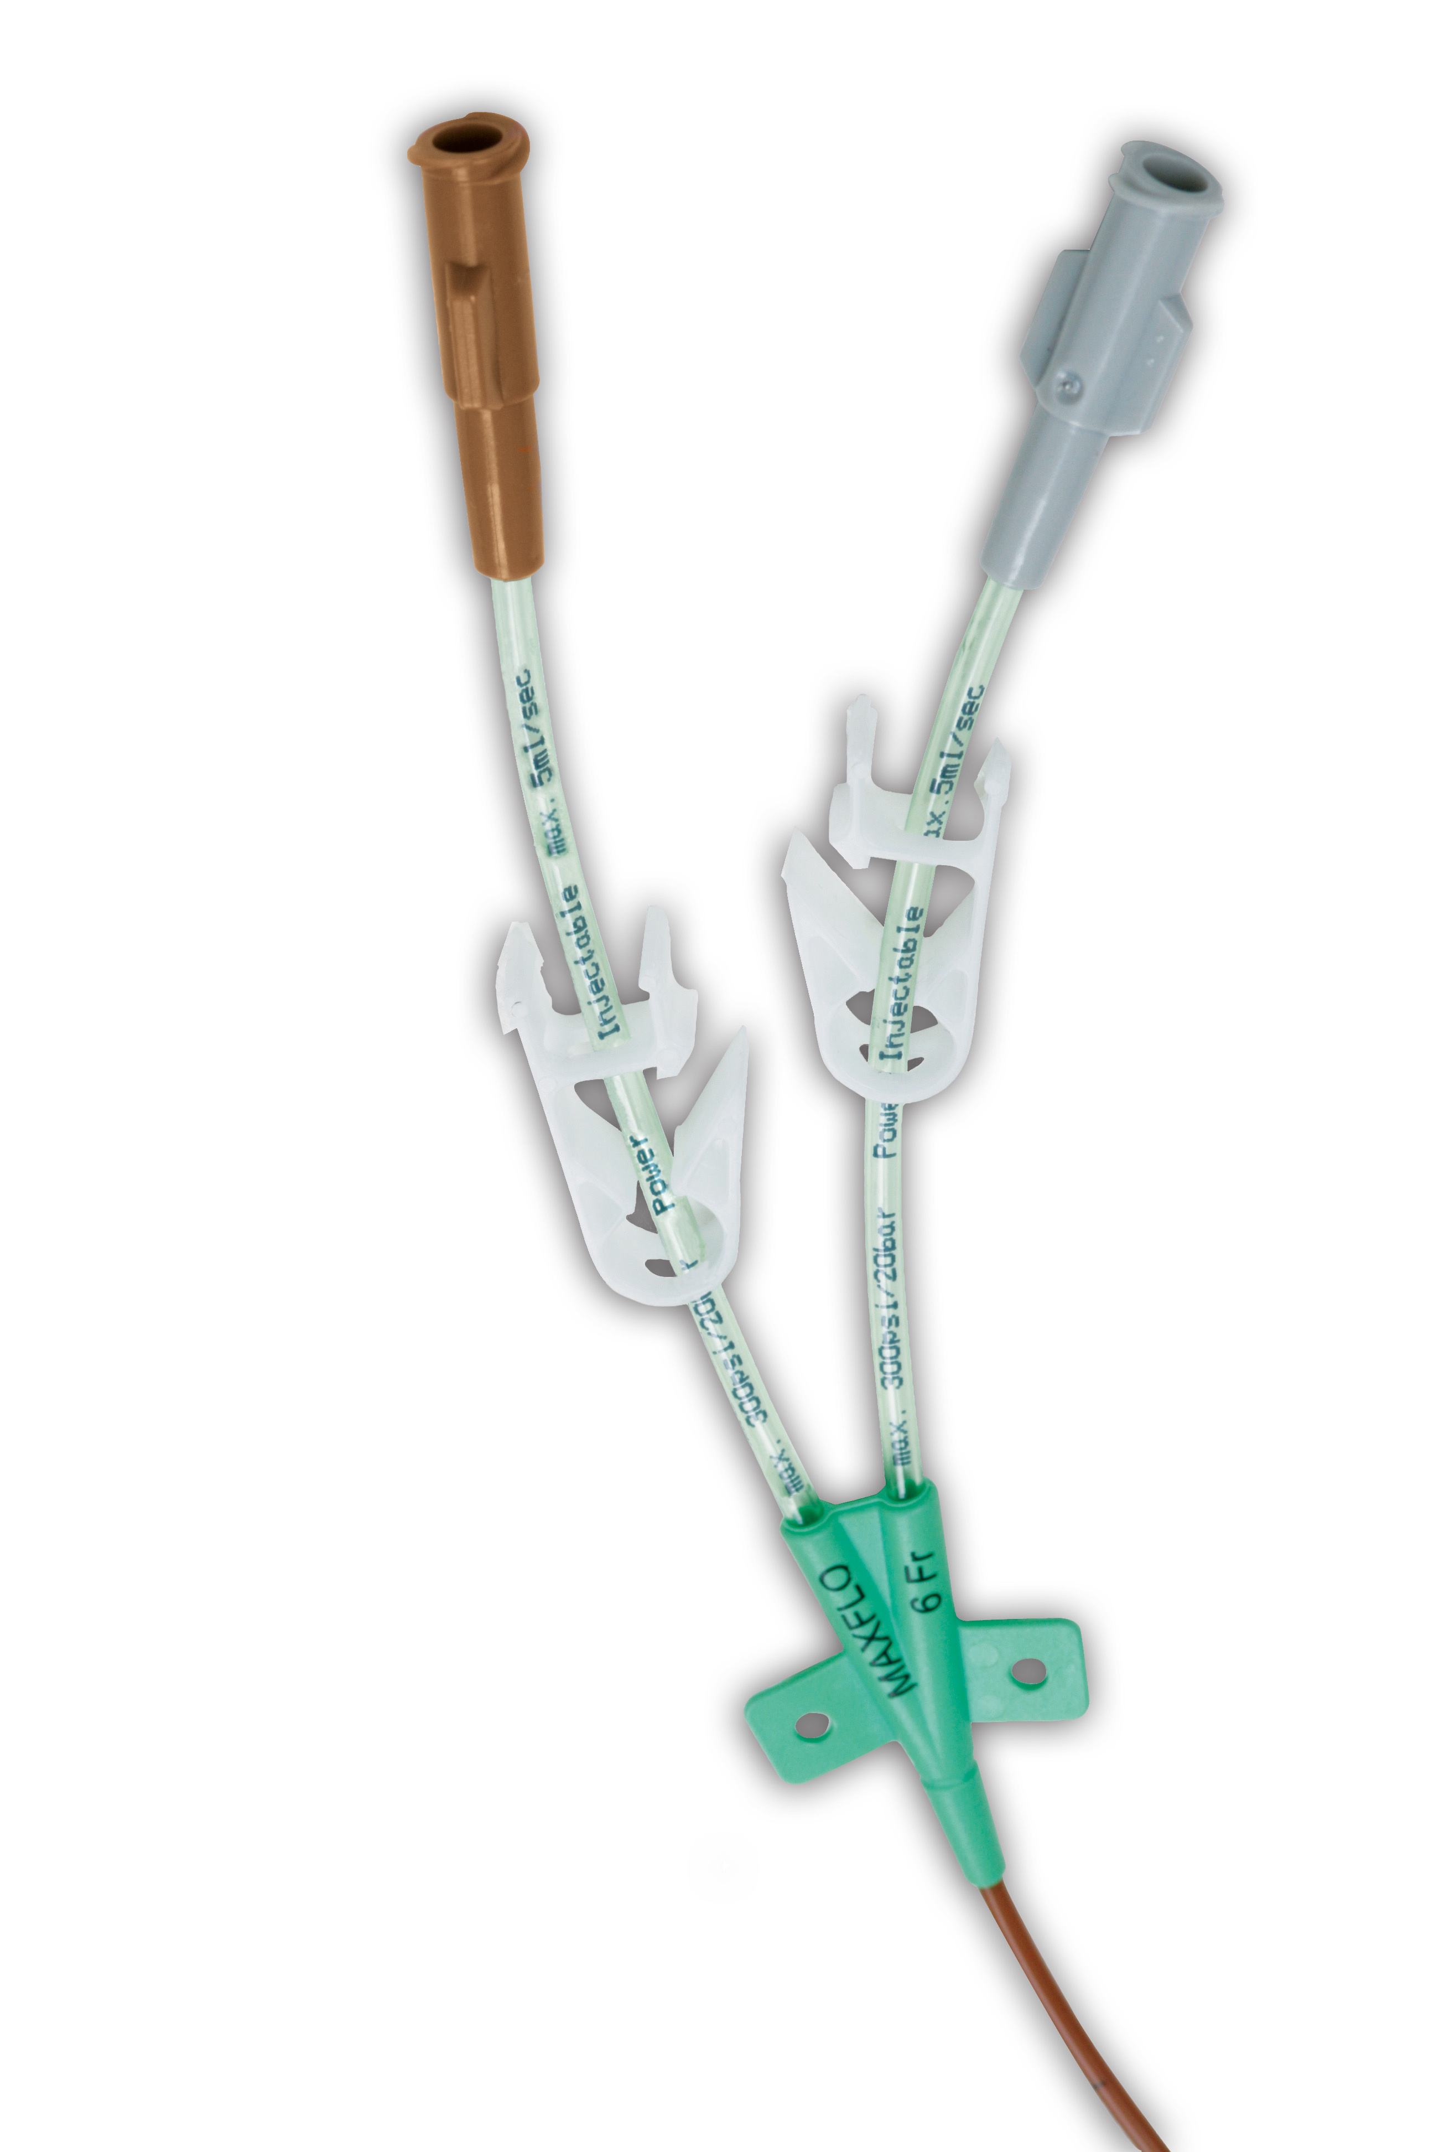
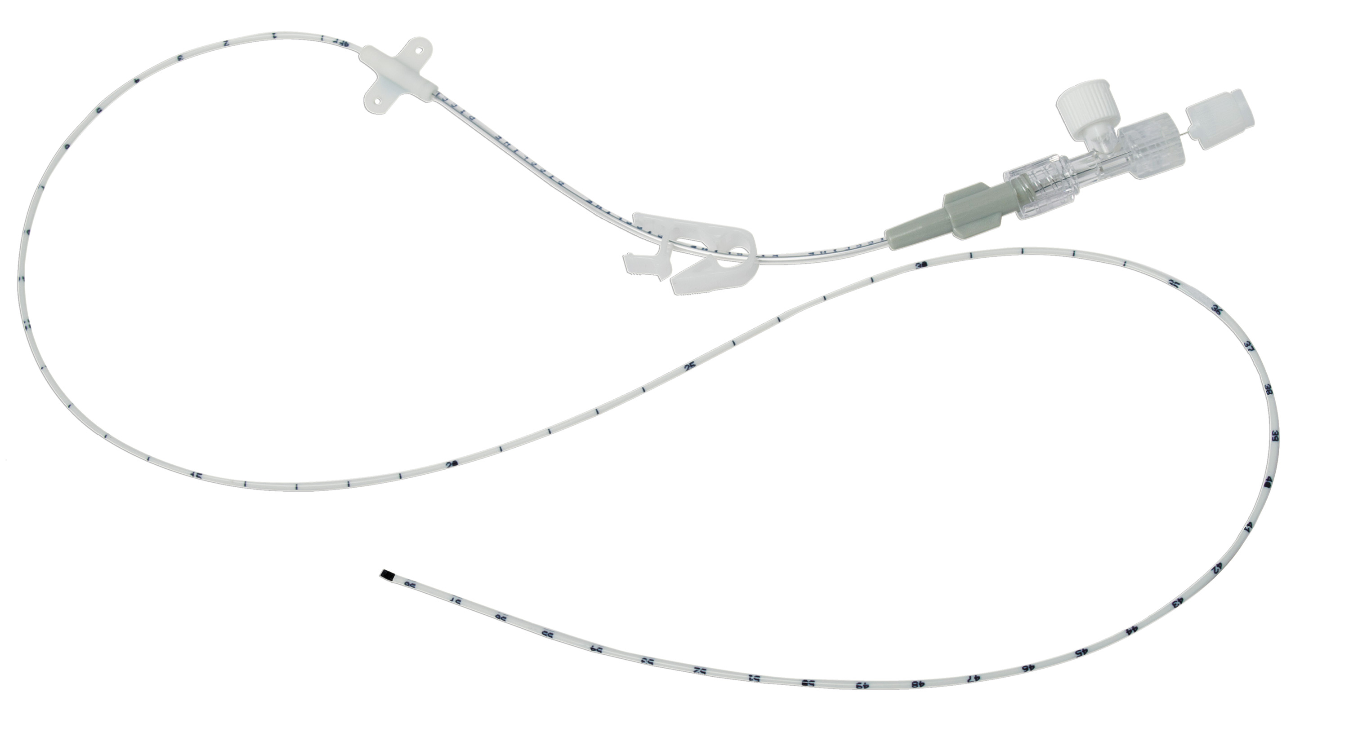
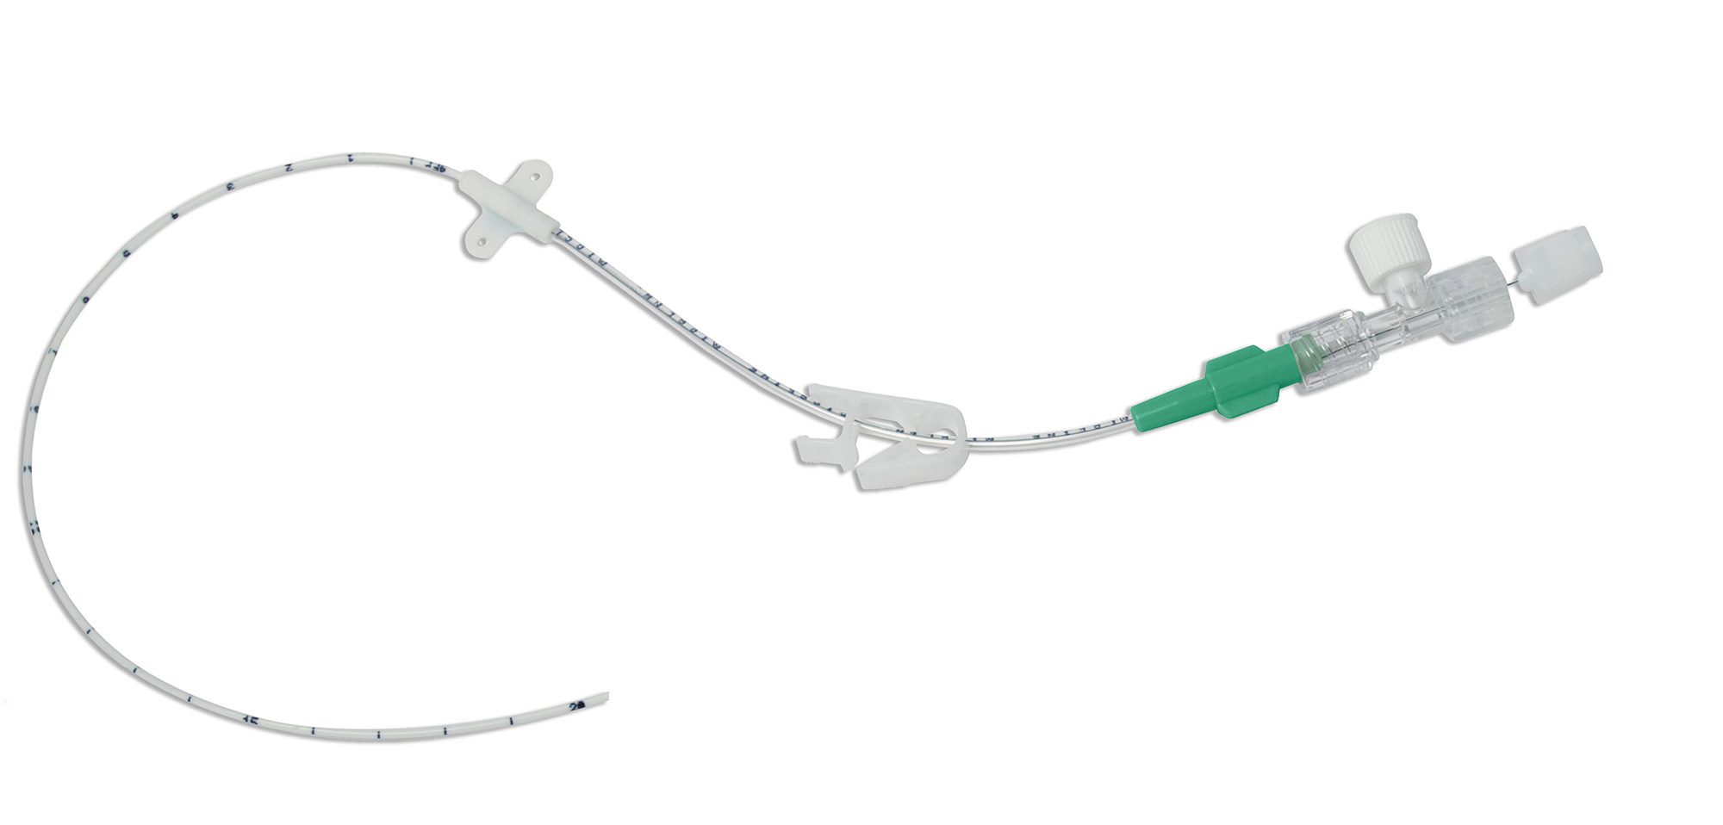
Midline Insertion
What Determines Which Vascular Access Device is Placed?

Slide 9
Midline Insertion
What Influences Your Choice of Vascular Access Device?
Duration and type of therapy (vesicant, irritant, hyperosmolar infusions)
Central venous pressure monitoring required?
Experience available to insert devices
Patient preference.
Select the:
Right device
Right location
Right time

Slide 10
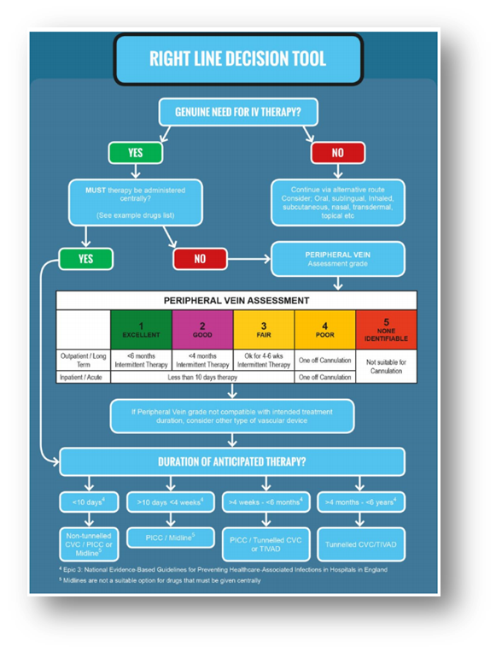
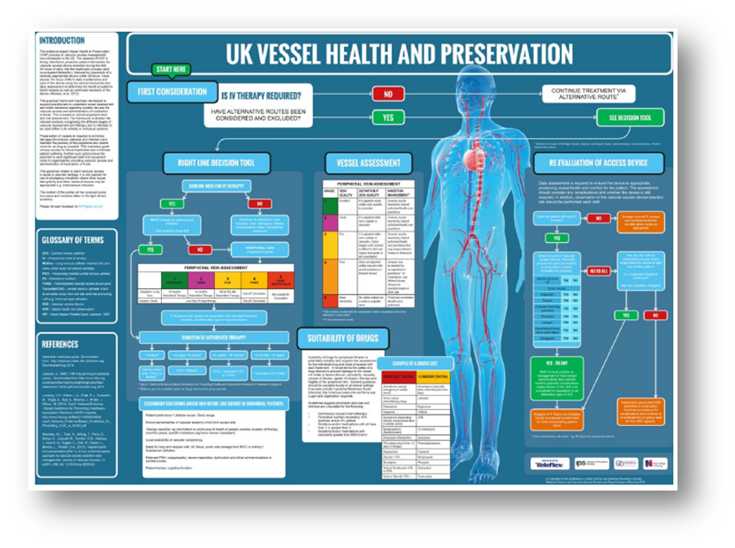
Midline Insertion
Catheter Selection Guide

Slide 11
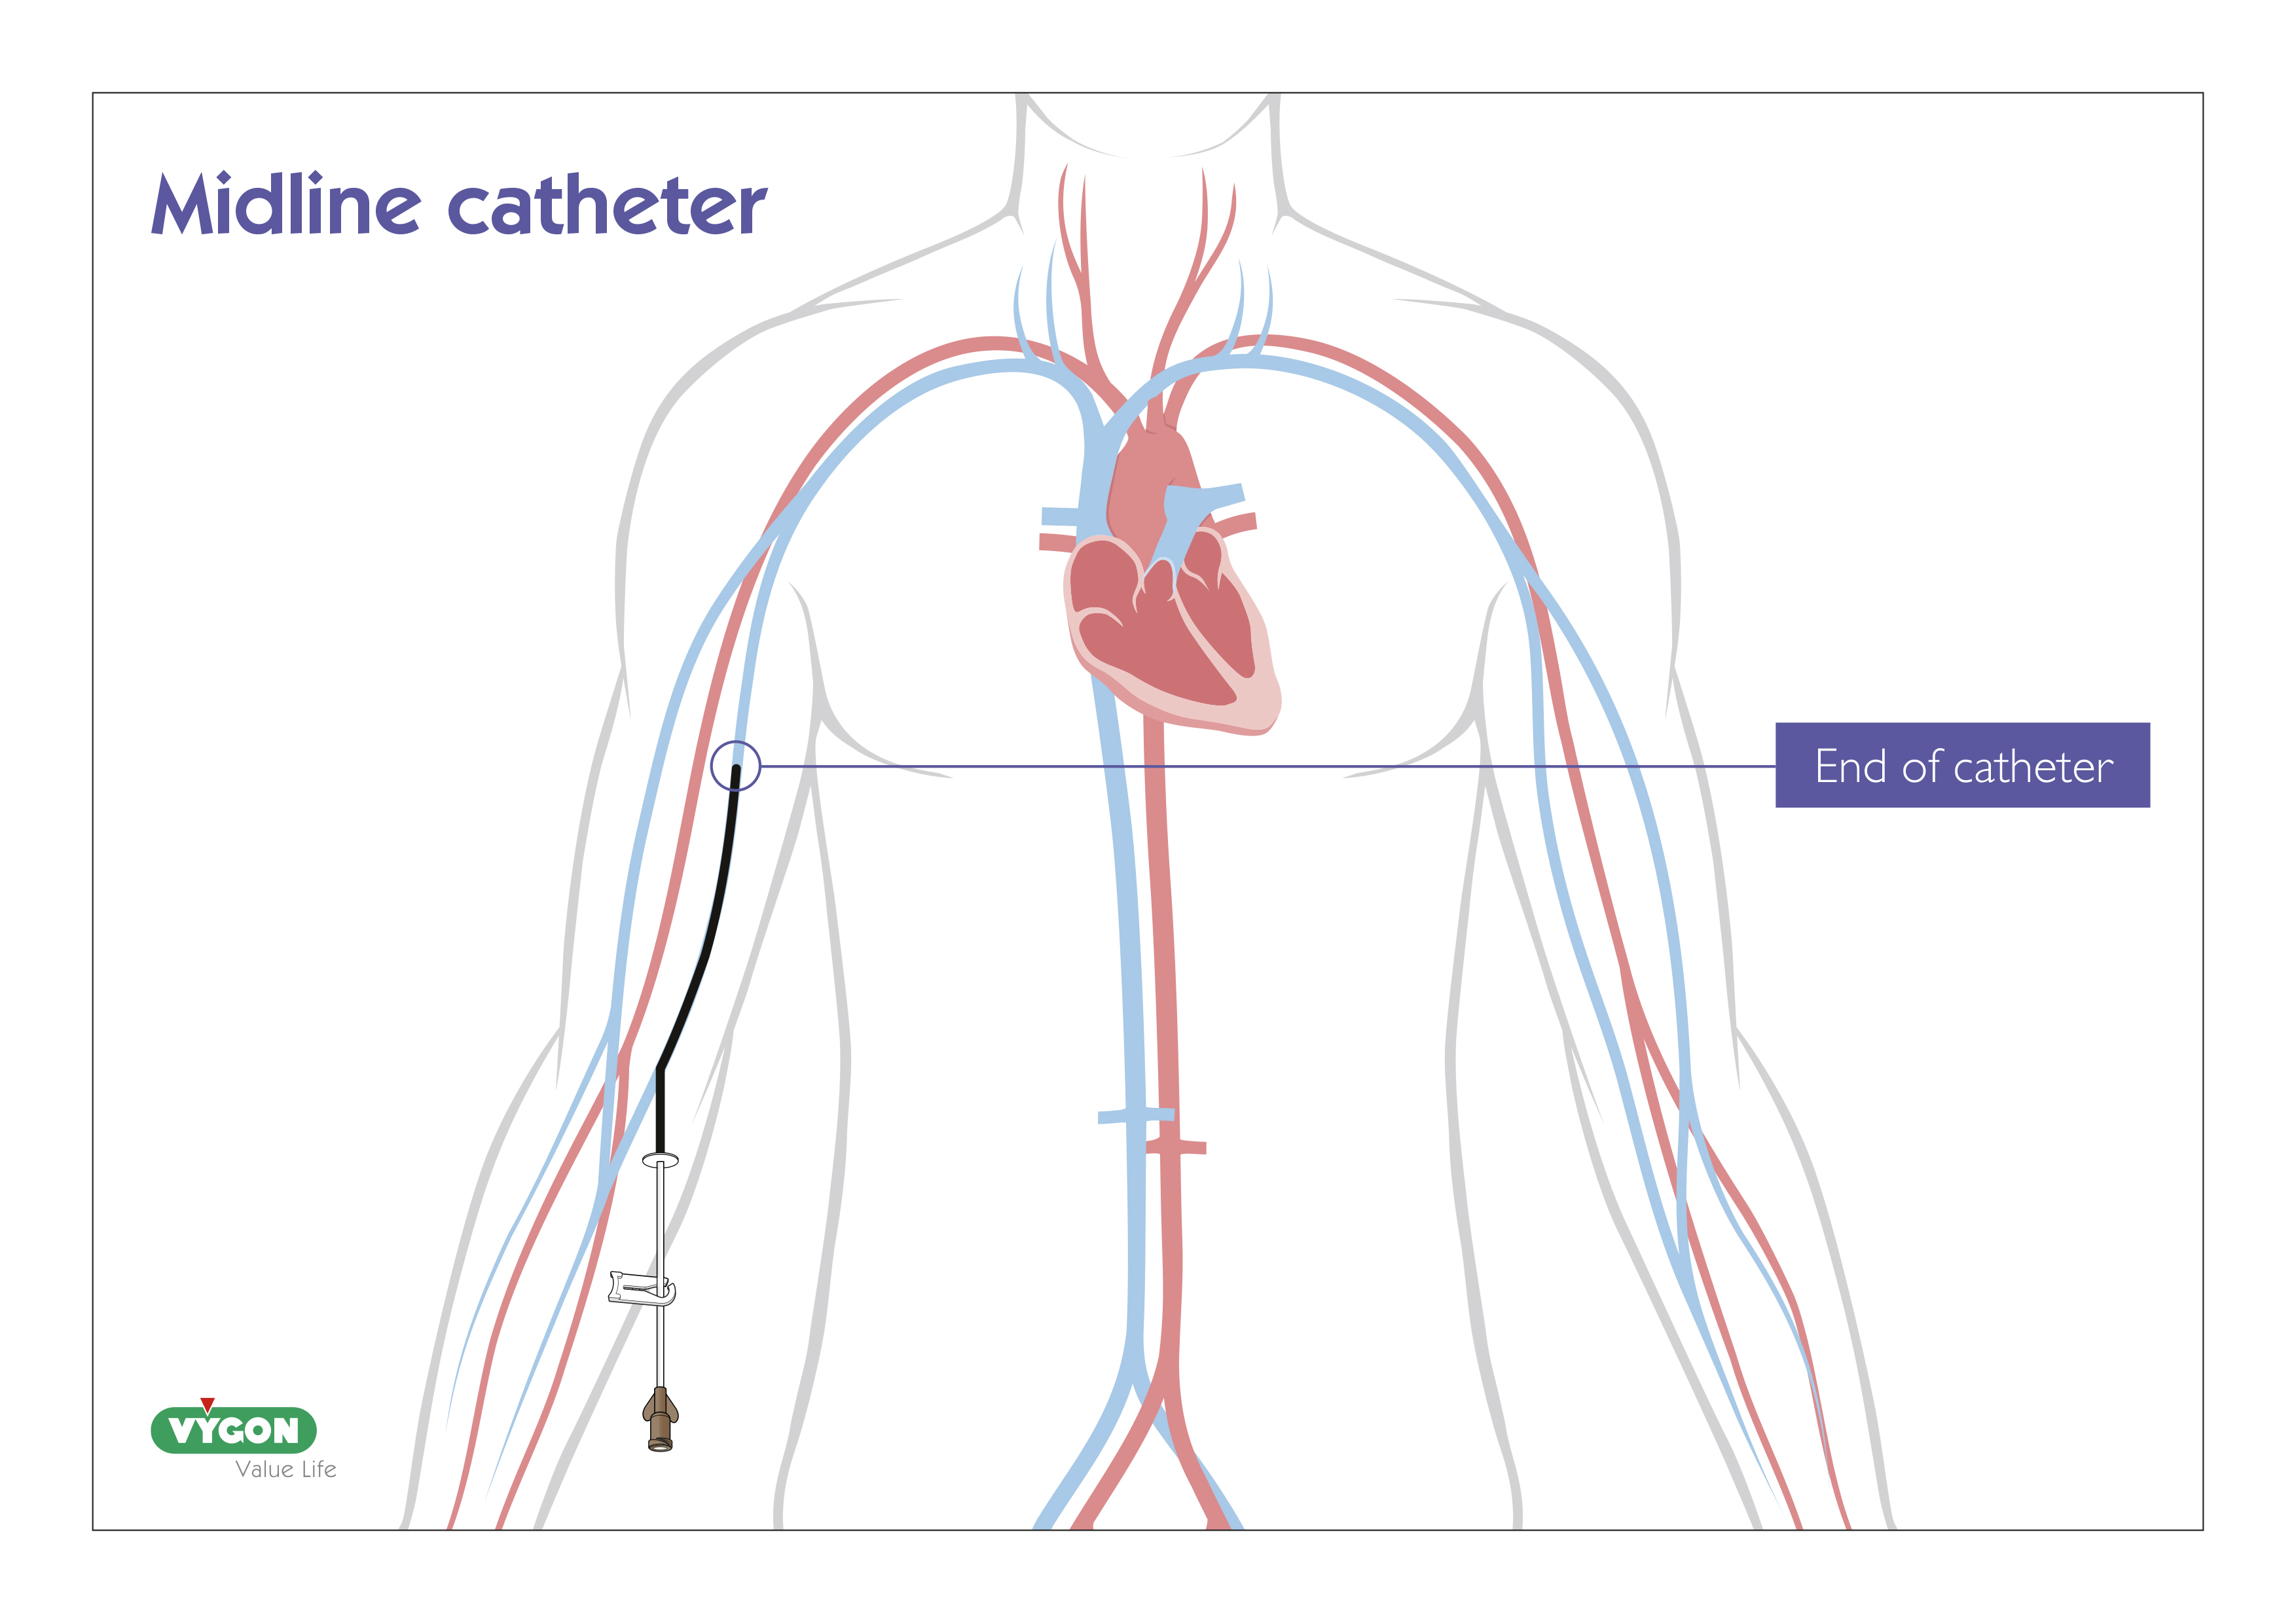
Midline Insertion
What is a Midline
Long lines / Extended dwell catheters / midlines
Midline devices are small catheters which are threaded through a peripheral (cephalic/ basilic/ brachial) vein with terminal tip before the axillary vein.
Can be inserted into the veins of the forearm or upper arm

Slide 12
Midline Insertion
Indications for Midlines
Extended duration of intravenous therapy (5 days or longer)
Peripherally compatible drugs
Poor venous access

Slide 13
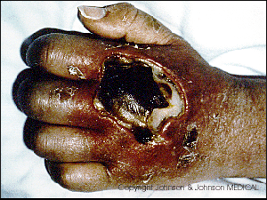
Midline Insertion
Contraindications
Mastectomy on side of insertion (risk of ipsilateral lymphedema)
Arterio – venous fistula on side of insertion
Drugs that require central vein delivery
Use caution with intermittent vesicant administration due to risk of undetected extravasation (INS (2016)

Slide 14
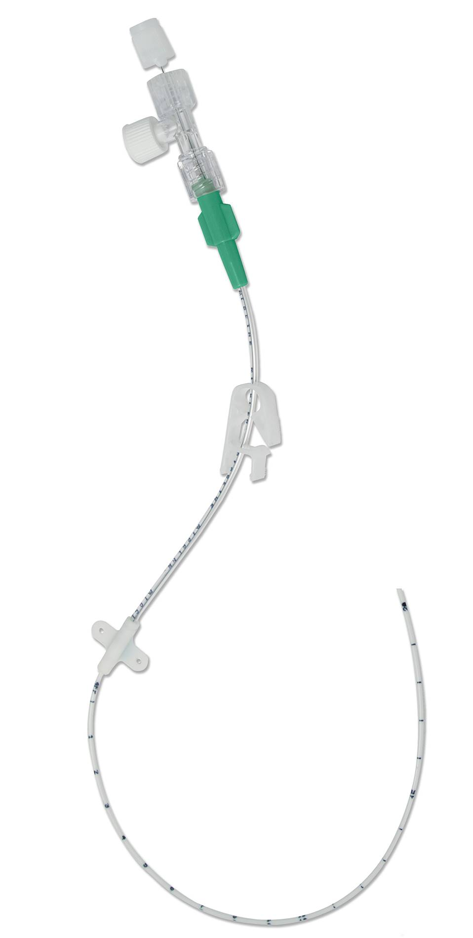
Midline Insertion
Benefits
No theatre time required as they are inserted at the bedside
Uninterrupted I.V. therapy as midlines can remain insitu for longer periods that a cannula.
Reduced complication rate
Preserves peripheral vascular system
No need for post procedure chest x-ray
Short learning curve for inserters.

Slide 15
Midline Insertion
Michigan Appropriateness Guide for Intravenous Catheters (MAGIC)
Midlines provides a long - term alternative to the CVAD when central access is not required or there is no clinical benefit to a CVAD (MAGIC study, Chopra, 2015)
665 scenarios
38% of PICCs were appropriate
43% were in inappropriate
19% uncertain

Slide 16
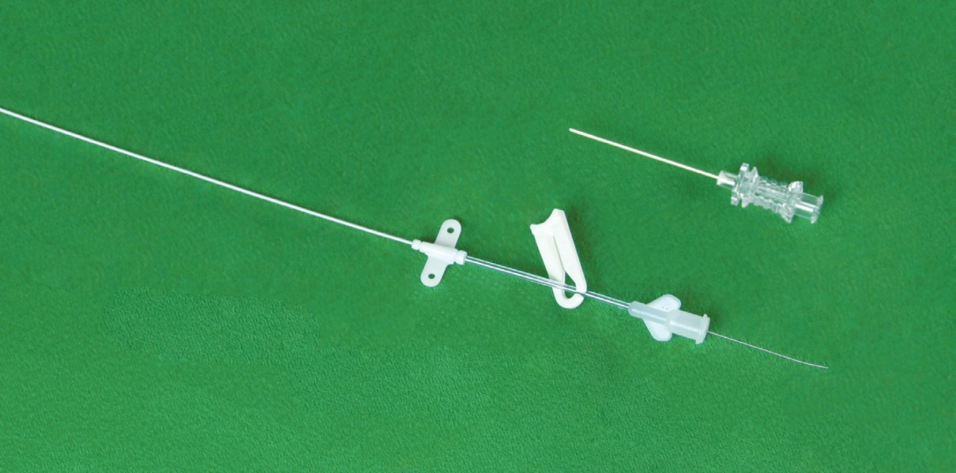
Midline Insertion
EDC / Midlines
Leaderflex: up to 29 days dwell
Smartmidline: up to 29 days dwell
Pressure tested
Lifecath midline: Dwell for length of treatment

Slide 17
Midline Insertion
Smartmidline
Device | Length (cm) | Maximum pressure | Maximum flow rate (viscosity 11.8cvP
Smart midline 2fr | 4 | 150 psi | 1.5 ml/s
Smart midline 2fr | 6 | 150 psi | 1.5 ml/s
Smart midline 2fr | 8 | 150 psi | 1ml/s
Smart midline 2fr | 10 | 150 psi | 1ml/s
Smart midline 2fr | 15 | 150 psi | 0.5ml/s
Smart midline 2fr | 20 | 150 psi | 0.5ml/s
Smart midline 3fr | 6 | 100 psi | 1.5ml/s
Smart midline 3fr | 8 | 100 psi | 1.5ml/s
Smart midline 3fr | 10 | 100 psi | 1.5ml/s
Smart midline 3fr | 12 | 100 psi | 1ml/s
Smart midline 3fr | 15 | 100 psi | 1 ml/s
Smart midline 3fr | 20 | 100 psi | 1 ml/s
Smart midline 4fr | 12 | 300psi | 5 ml/s
Smart midline 4fr | 15 | 300psi | 5 ml/s
Smart midline 4fr | 20 | 300psi | 5 ml/s
Smart midline 4fr | 25 | 300psi | 5 ml/s

Slide 18
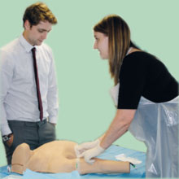
Midline Insertion
Insertion Technique

Slide 19
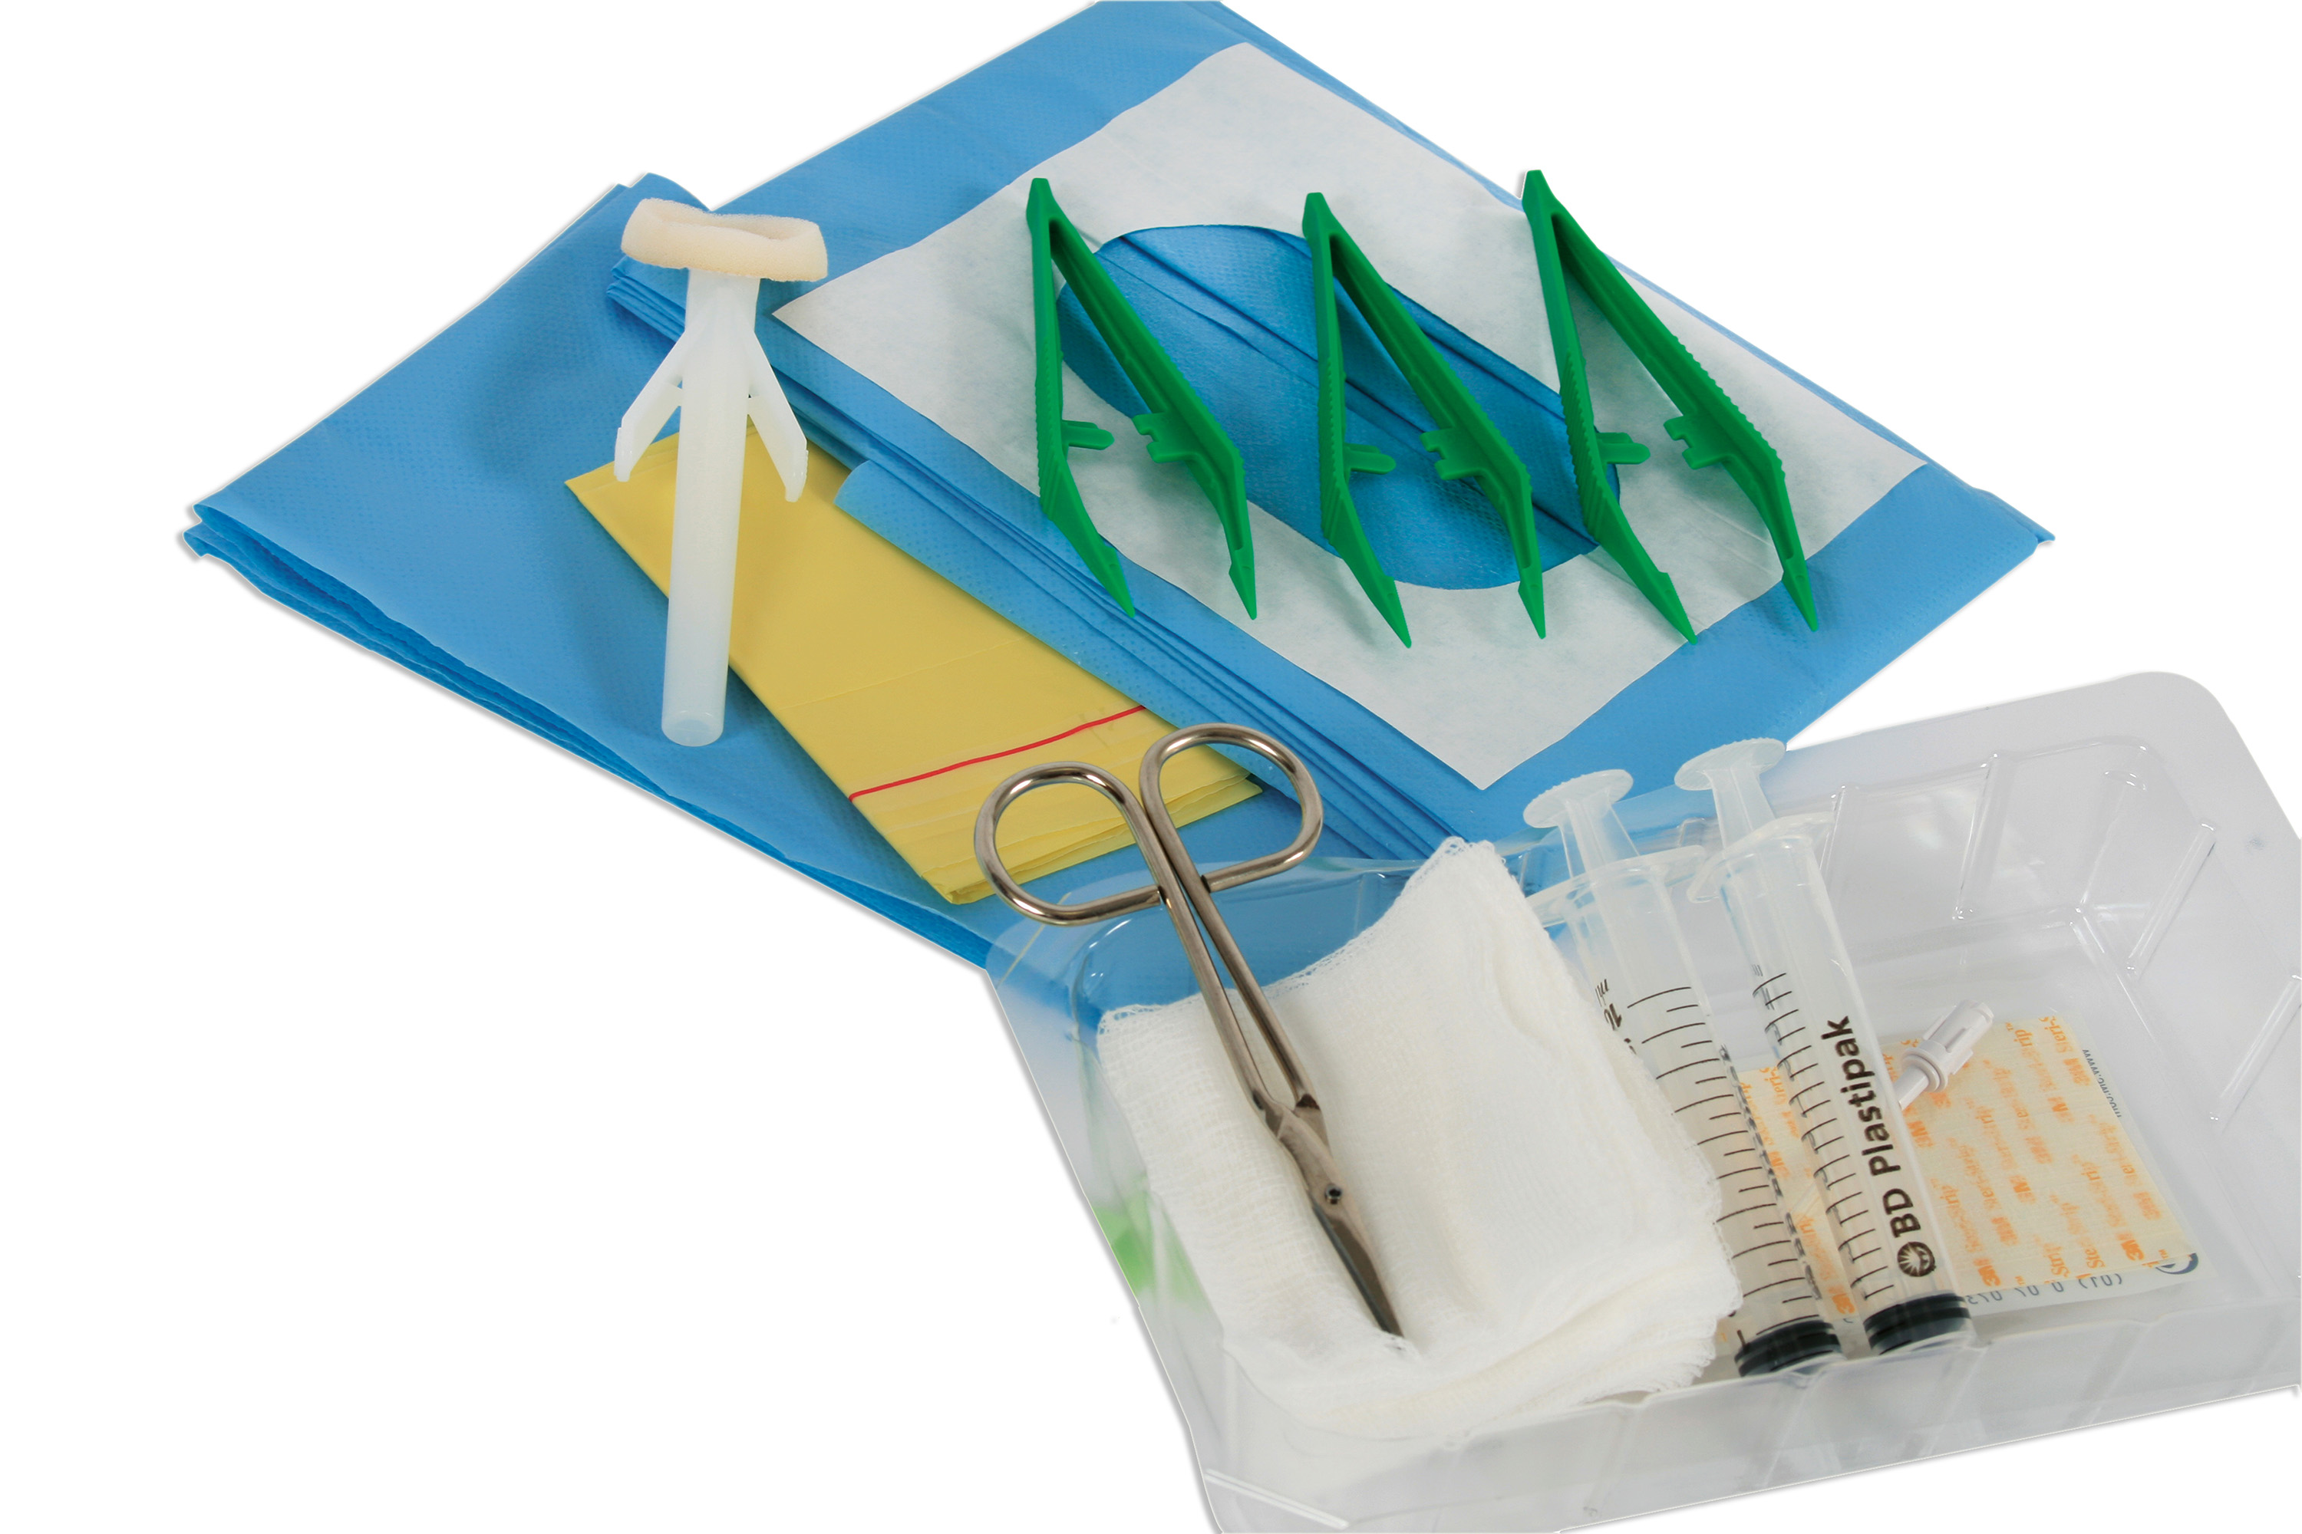
Midline Insertion
PICC / Midline insertion pack

Slide 20
Midline Insertion
Procedure: Preparation
Explain procedure to patient
Gain consent
Place patient supine with arm extended approx. 90º to the trunk.
Apply tourniquet
Identify suitable vein– loosen tourniquet
Clean skin (allow to dry)
Apply drape
Administer local anaesthetic if necessary
Prime catheter and prepare equipment

Slide 21
Midline Insertion
Seldinger Techniques
Seldinger Technique (Leaderflex)
Needle Wire Catheter
Modified Seldinger (Lifecath)
Needle Wire Peel away sheath Catheter

Slide 22
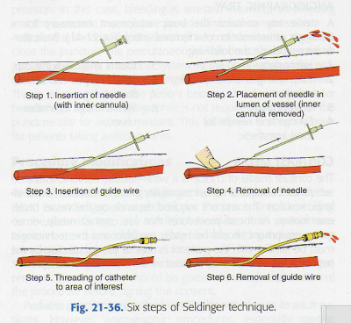
Midline Insertion
Six Steps of Seldinger Technique

Slide 23
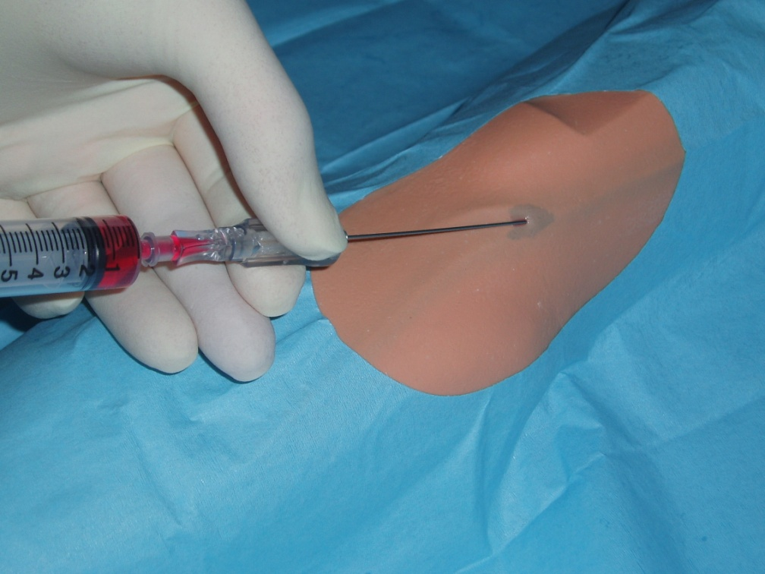
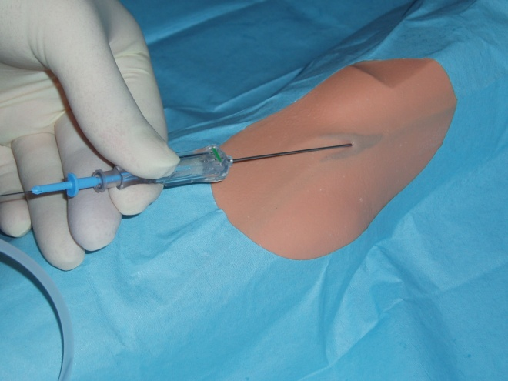
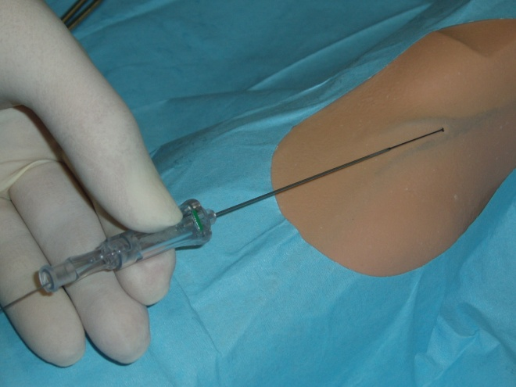
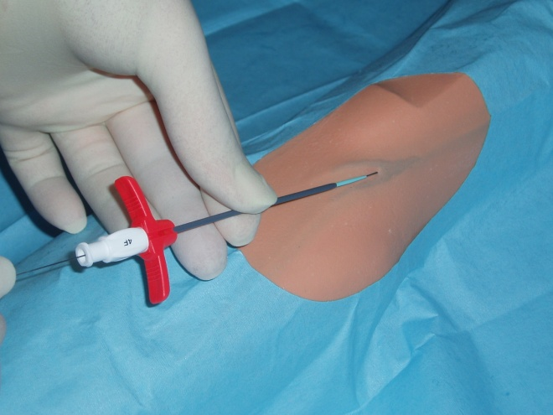
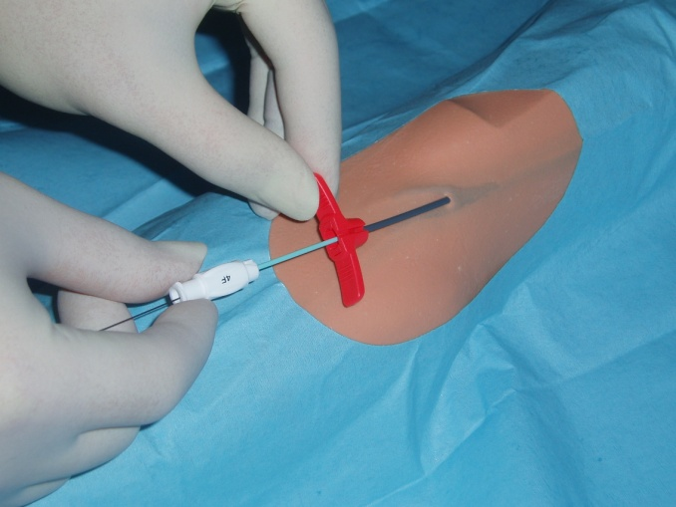
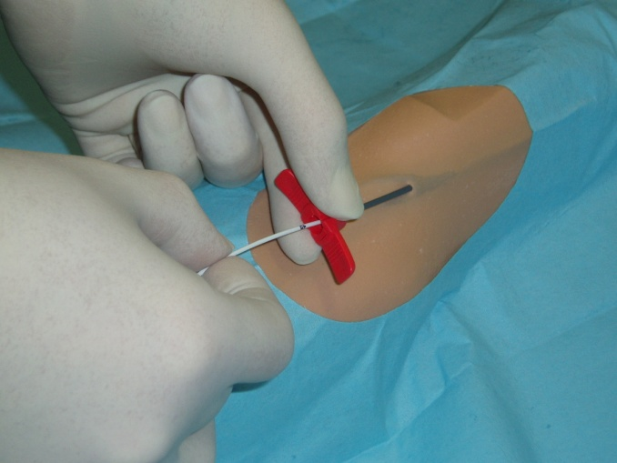
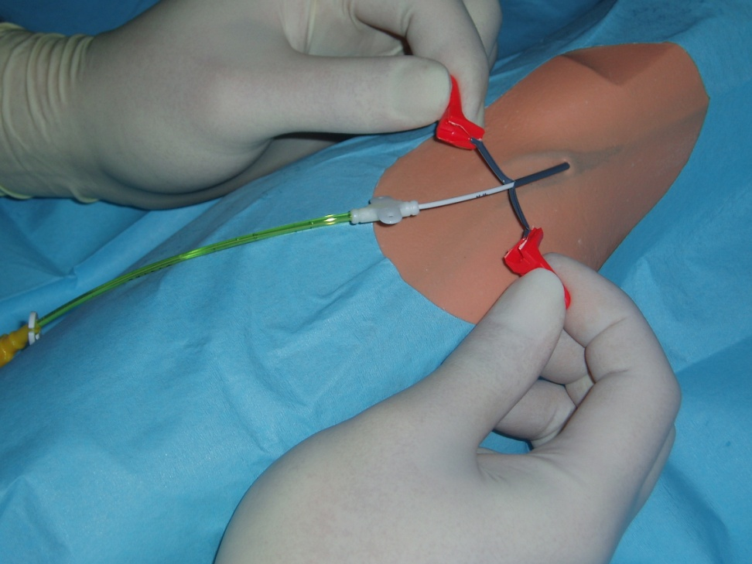
Midline Insertion
Modified SeldingerTechnique (MST)
Access vein
Insert wire
Insert Peel – away sheath
Remove both wire and dilator
Insert catheter
Peel sheath away

Slide 24
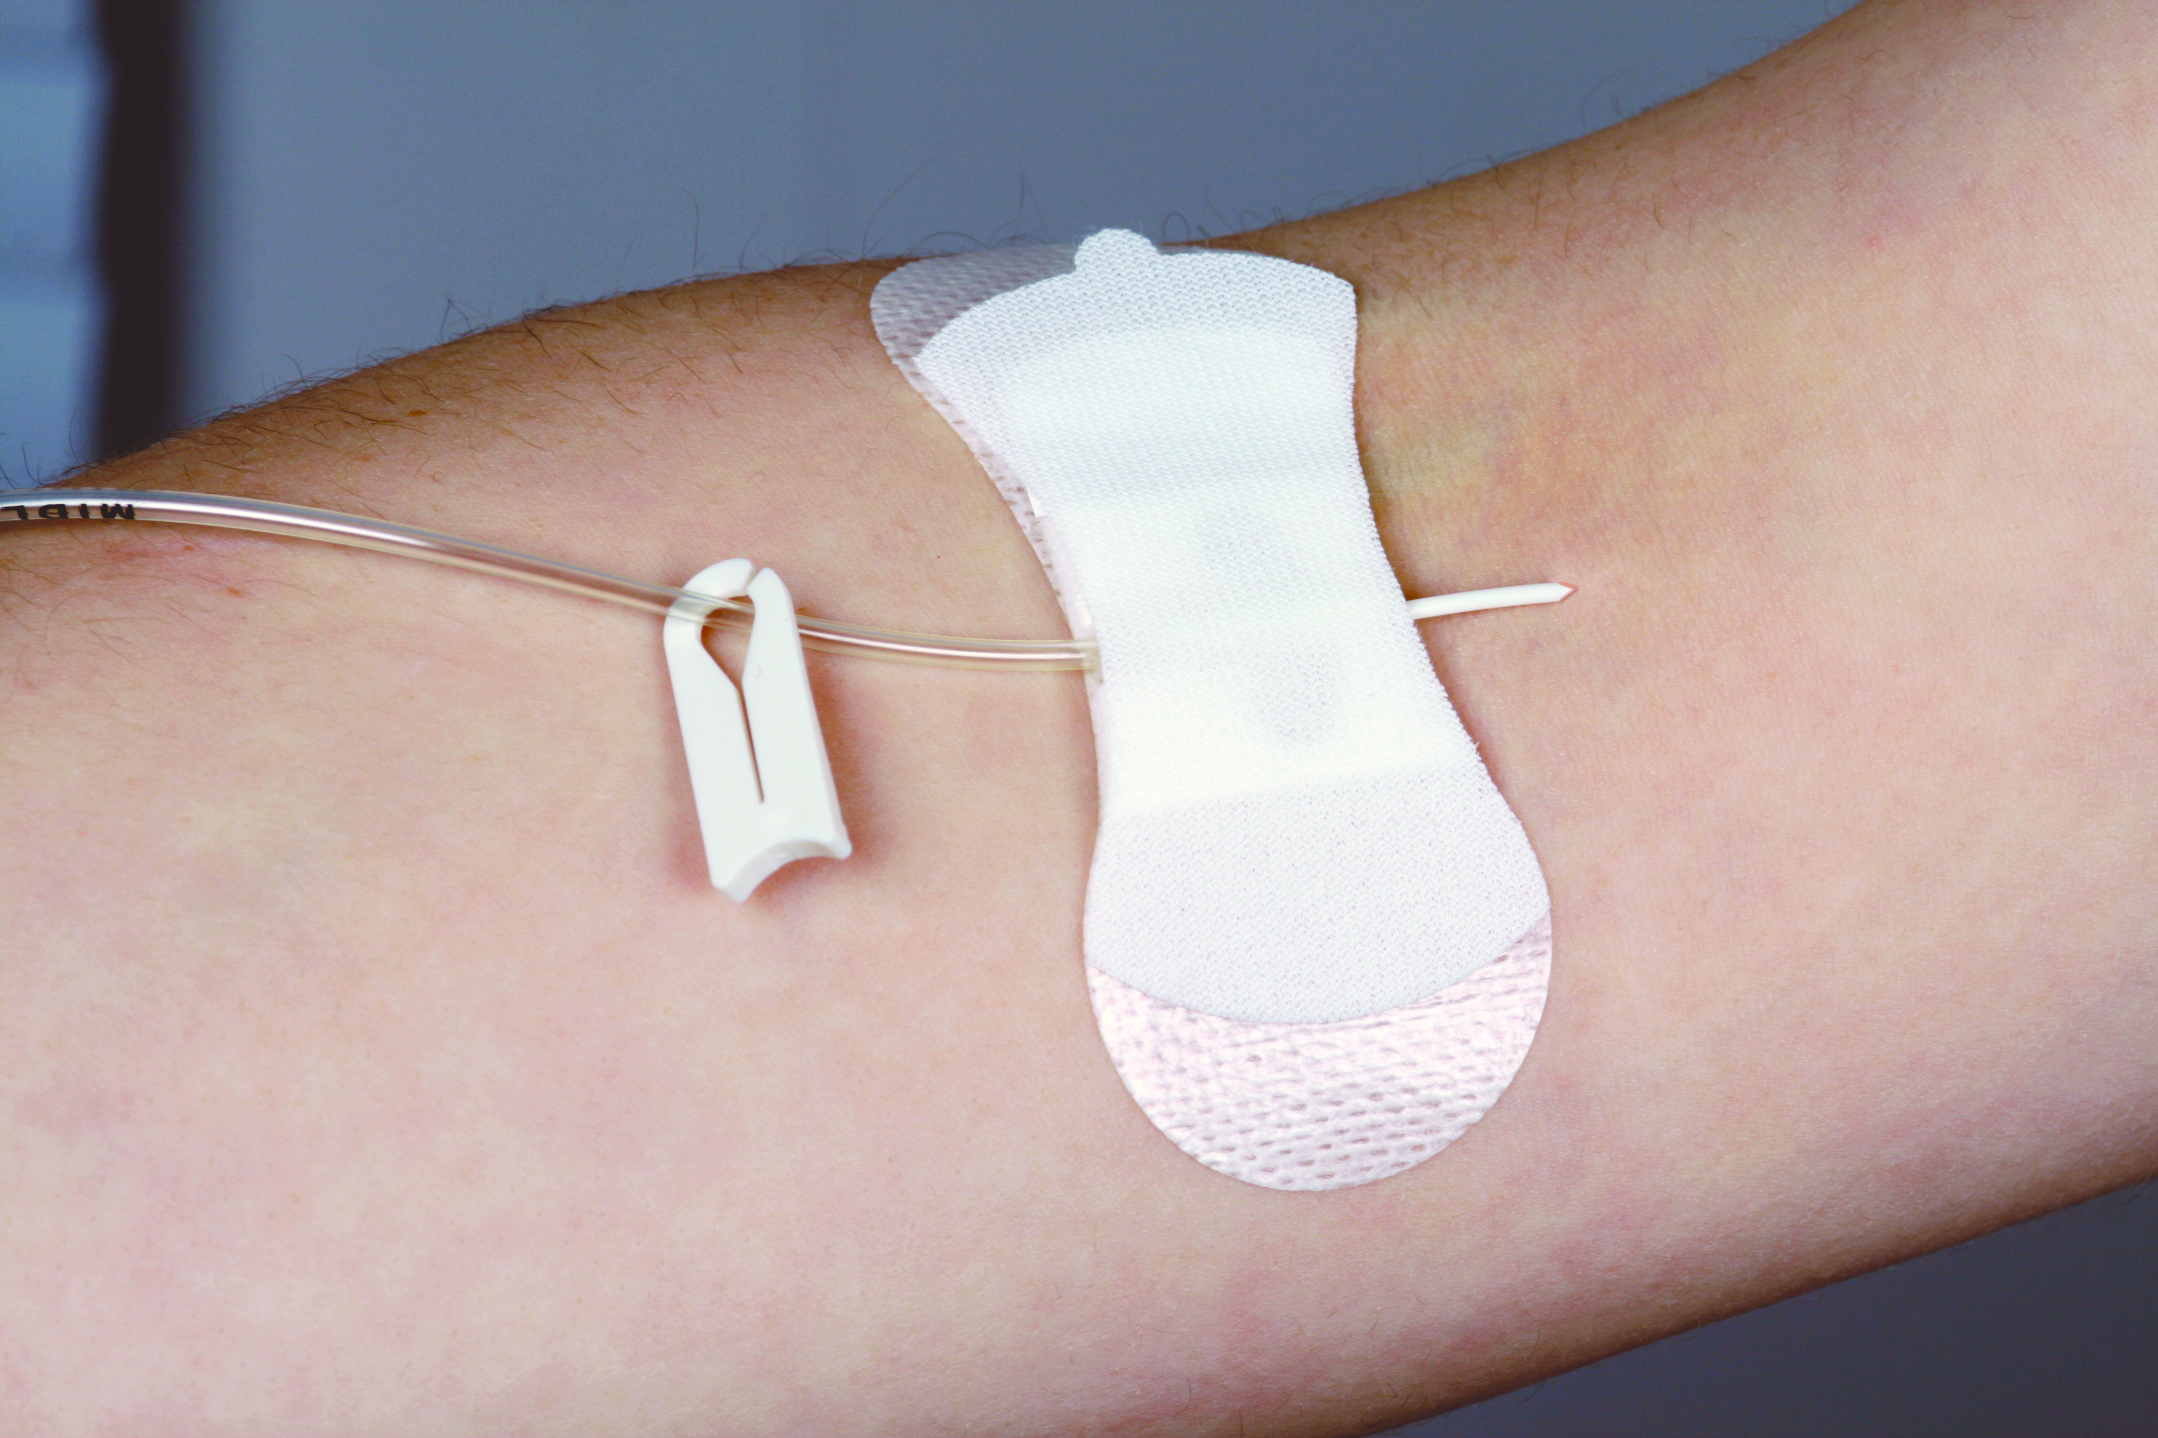
Midline Insertion
Post Procedure
Aspirate and flush catheter using a 10ml syringe.
Flush using a push / pause turbulent flush technique.
Apply Bionector TKO
Stabilise with a Giplok and or surgical glue
Apply a bioclusive dressing
Ensure patient and staff education.
Record details of insertion
(Lot number/length/expiry date)

Slide 25
Midline Insertion
Complications
Difficulty in accessing vein
Arterial puncture
Nerve injury
Difficulty threading Midline
Malposition of tip (too long)

Slide 26
Midline Insertion
Care of a Midline
Care Bundle
Remove if no longer required
Use a needle-free device –BionectorTKO – change weekly
Use Griplok to secure catheter – change weekly
Cover site with bioclusive dressing – change weekly (or more frequently if required)
Following use flush with 10mls 0.9% sodium chloride (Push / Pause positive flush)
Record in notes

Slide 27
Midline Insertion
Patient Information
Patient advice:
Inform staff of any discomfort/redness/ swelling/ pain or leakage experienced
Avoid strenuous exercise.
Dressing is waterproof so can shower
Patient information leaflet available

Slide 28
Midline Insertion
Summary
It has been recognised that the midline offers greater quality of care to patients; as it prevents the need for repeated cannulation and associated complications.
It should be noted, for example, that a patient whose line remains insitu for 29 days would have 10 cannula placed in this time.
Another option where no clinical benefit for Central Venous Access Device.

Slide 29
Midline Insertion
Video
Ultrasound Guided Leaderflex insertion
Add: smart midline insertion**
Add: smartmidline insertion with dilator**
Add: Lifecath midline insertion**

Slide 30
Midline Insertion
Practice Session

