Slide 1
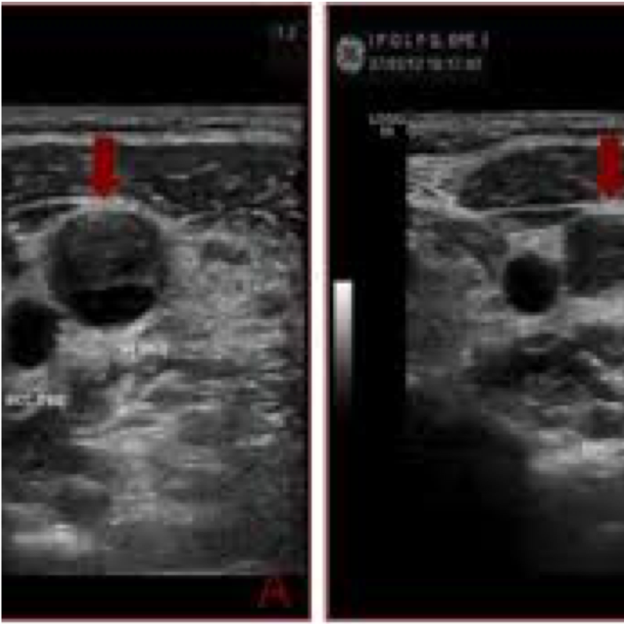

Ultrasound Guidance for Venous Access

Slide 2
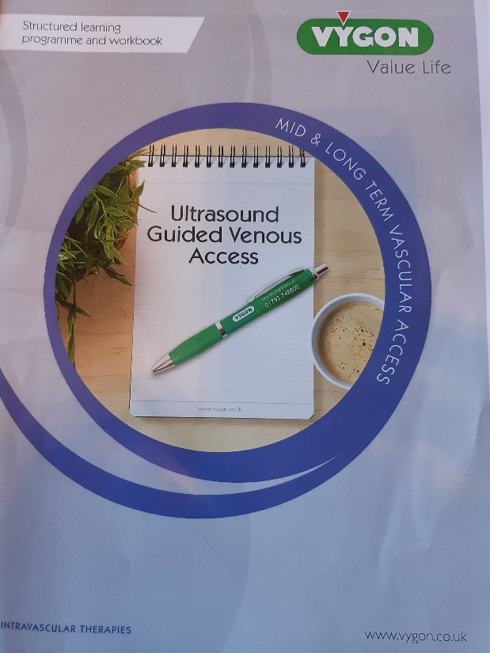

Ultrasound Guidance for Venous Access
Content

Slide 3
Ultrasound Guidance for Venous Access
Agenda
Theory - Why ultrasound guidance?
Theory - Basic ultrasound physics
Theory - Anatomy as it relates to ultrasound
Theory - Vascular Access using ultrasound

Slide 4
Ultrasound Guidance for Venous Access
Learning Outcomes
Develop and understand the principles of sound.
Equip you with a basic understanding of the principles of ultrasound.
Develop an understanding of how ultrasound waves are impacted by tissue.
Develop understanding of skills required to perform ultrasound guided vascular access

Slide 5
Ultrasound Guidance for Venous Access
Why Ultrasound Guidance?
Hundreds of thousands of vascular access devices placements per year in NHS
  Short - term
  Long - term
Blind landmark technique to locate vessel and guide needle into target vessel increases risks to patient.
Recently ultrasound has been used to access veins for peripheral access (cannula, PICCs, arterial).

Slide 6
Ultrasound Guidance for Venous Access
Why Ultrasound?
Ultrasound is the most commonly used imaging technology used worldwide.
Why?
Popular due to:
  Availability – portability
  Speed
  Low cost
  Patient friendly / safety – no radiation

Slide 7
Ultrasound Guidance for Venous Access
Guidelines to support
National Institute for Clinical Excellence (NICE) (2002)
Centre for Disease Control (CDC) (2012)
EPIC3 (2014)
Cochrane Report (Brass et al 2015)
Association for Professionals in Infection Control and Epidemiology (APIC) (2016)
Infusion Nurses Society (INS) (2016)
Association of Anaesthetists of Great Britain and NI (AAGBI) (2016)

Slide 8
Ultrasound Guidance for Venous Access
Literature to Support
Randolph (1996)
Rotschild (2001)
Keenan (2002)
Calvert (2003)
Brealey et al (2009)
Lamperti et al(2012)
Cochrane Report – CVC’s (2015)
etc. etc. etc….

Slide 9
Ultrasound Guidance for Venous Access
Literature Support
“the use of real-time two-dimensional ultrasound for the placement of central venous catheters substantially decreased mechanical complications and reduced the number of attempts at required cannulation and failed attempts at cannulation compared with the standard landmark placement.”

Slide 10
Ultrasound Guidance for Venous Access
Blind Technique associated with:
Missed Target
Multiple Punctures
Failure
Wrong Target
Arterial Puncture
Nerve damage

Slide 11
Ultrasound Guidance for Venous Access
Venous Access Using Ultrasound
Is not difficult, requires minimal training
Reasonably short learning curve
An excellent teaching tool

Slide 12
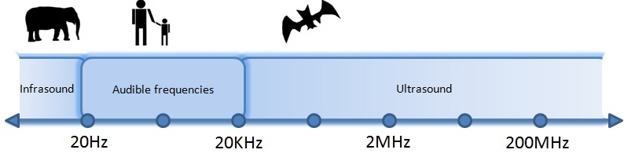
Ultrasound Guidance for Venous Access
Basic Ultrasound and Venous Anatomy
Definition of US
Mechanical Pressure Wave
Measured in Hertz (HZ)

Slide 13
Ultrasound Guidance for Venous Access
Wave defined by: Frequency, Wavelength & Aptitude
Frequency is a measure of pressure cycles over time.
Wavelength is the distance from crest to crest.
Amplitude is the distance of the highest peak or crest value

Slide 14
Ultrasound Guidance for Venous Access
Wavelength & Frequency
Inverse relationship between wavelength and frequency
Shorter wavelength = Higher frequency
Longer wavelength = Longer frequency

Slide 15
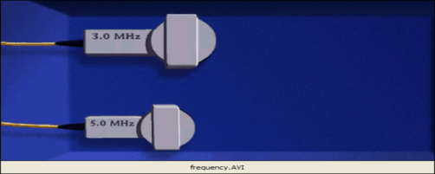
Ultrasound Guidance for Venous Access
Frequency v Resolution
The thickness of the crystal determines the frequency
High Frequency
5 – 10 Mhz
Vibrates at a higher cycle
Wavelength closer together
Less penetration
Shallow structures
Greater resolution
Low frequency
2 - 3.5 Mhz
Vibrates at a lower cycle
Wavelength spread out
More penetration
Deeper structures
Less resolution

Slide 16
Ultrasound Guidance for Venous Access
Ultrasound Imaging
  1. Transducer elements (crystals) convert electrical to mechanical energy and vice versa (Piezoelectric Effect).
2. Initiate sound wave by system
3. Transmission through tissue
4. Causes tissues to compress
5. Reflection off of structures
6. Signal returns to system (transducer)
7. Image produced
This all happens simultaneously

Slide 17
Ultrasound Guidance for Venous Access
Image Formation
Electrical signal produces a series of ‘dots’ on the screen
Need to be aware of anatomy to interpret these ‘dots’
Brightness of dots is proportional to the density of the structure/ time of return
Brighter = More dense (echo return is faster).

Slide 18
Ultrasound Guidance for Venous Access
US Appearance of Blood Vessels
Brachial vein | Echopoor (BLACK)
Brachial artery | Echopoor
Brachio cephalic Vein | Echopoor (Valves)
Muscles | Less echogenic
Clavicle | Echogenic
Basilic vein | Echopoor
Nerves | Honeycomb appearance

Slide 19
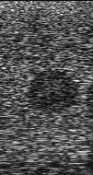
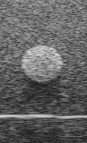
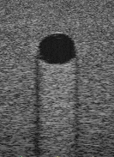

Ultrasound Guidance for Venous Access
Echogenicity
Hypoechoic
Less echogenic than surrounding tissue
Hyperechoic
More echogenic than surrounding tissue
Anechoic
Absence of Echoes
Isoechoic
Same echogenicity as surrounding tissue

Slide 20
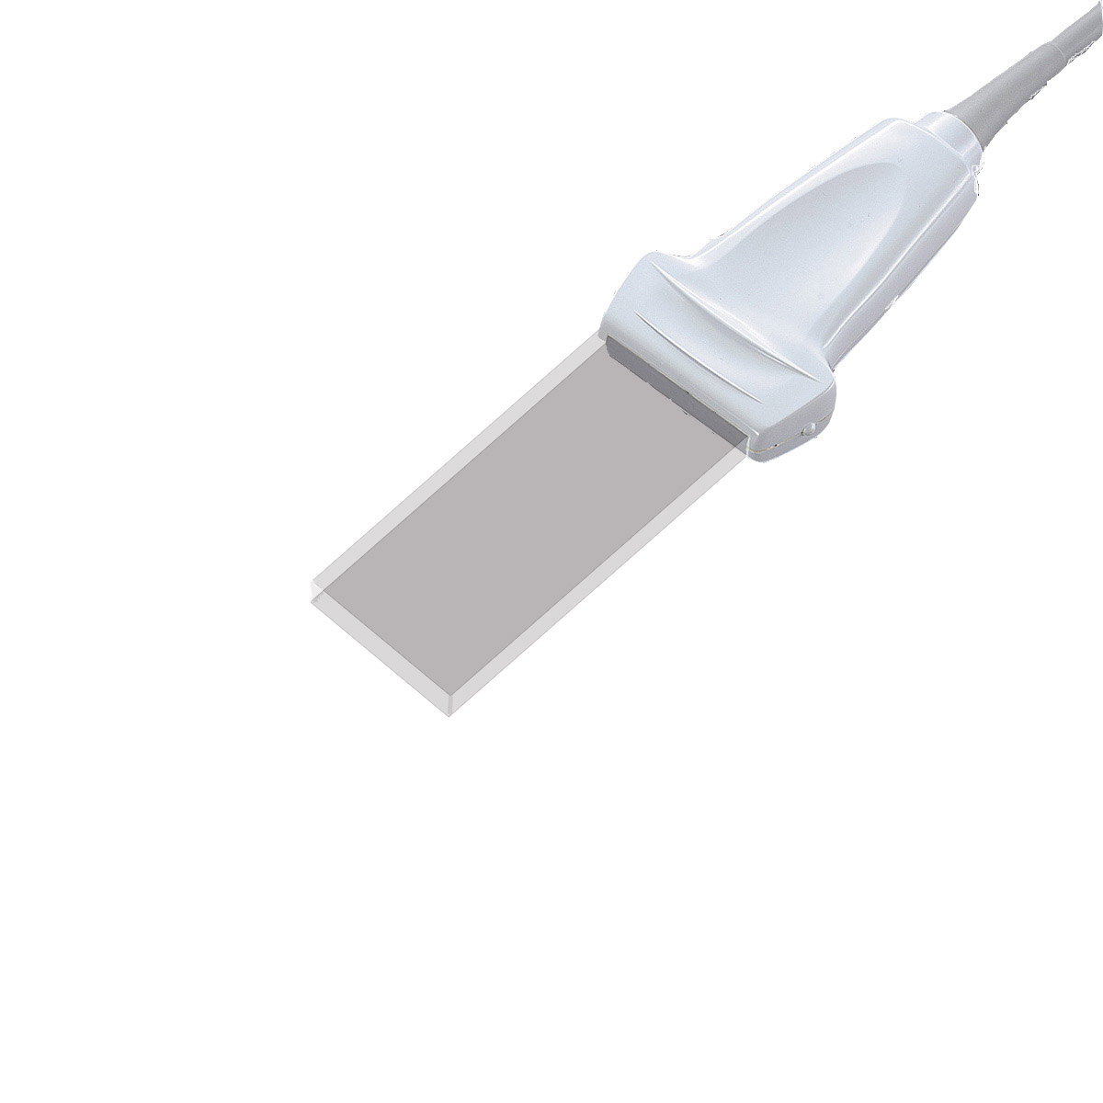
Ultrasound Guidance for Venous Access
Transducer
Beam Profile
  Length of the transducer face x 1 mm thick
  Length of beam dependent upon selected depth
Beam width – 1mm

Slide 21
Ultrasound Guidance for Venous Access
Transducer Orientation
Markings are located on one side of transducer only and correspond to orientation marker on screen.

Slide 22
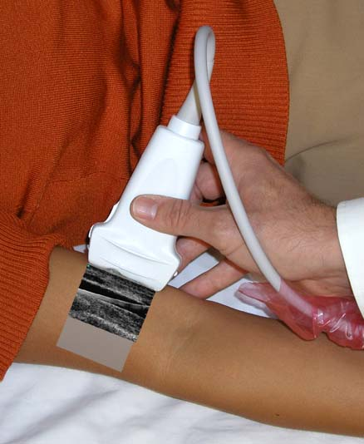
Ultrasound Guidance for Venous Access
Transducer Orientation
Transverse
Longitudinal

Slide 23
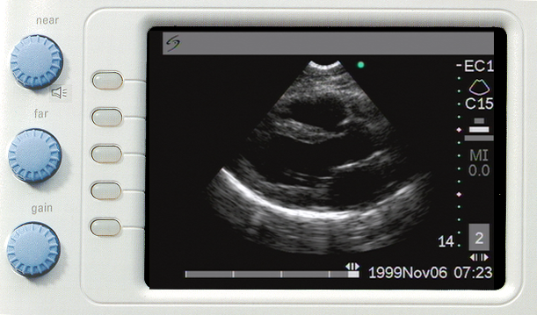
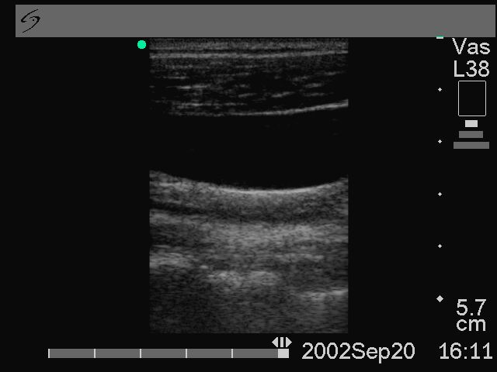
Ultrasound Guidance for Venous Access
Transducer
Transducer contacts skin
Deeper or away from the skin

Slide 24
Ultrasound Guidance for Venous Access
Why use Ultrasound Gel?
Coupling Agent
Ultrasound is reflected at an air interface
Gel provides medium for sound wave into the body by removing air gap

Slide 25
Ultrasound Guidance for Venous Access
Gain
Gain controls the brightness of the displayed image
Can be adjusted as near, far or overall
One of the commonest mistakes in ultrasound imaging is the use of incorrect gain settings.
Insufficient gain can result in missed structures of low reflectivity, such as thrombus.
Excessive gain can result in false echos or oversaturation, which may obscure important diagnostic image characteristics such as shadowing or enhancement

Slide 26
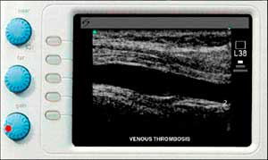
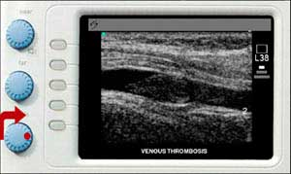
Ultrasound Guidance for Venous Access
Image Optimization-Gain

Slide 27
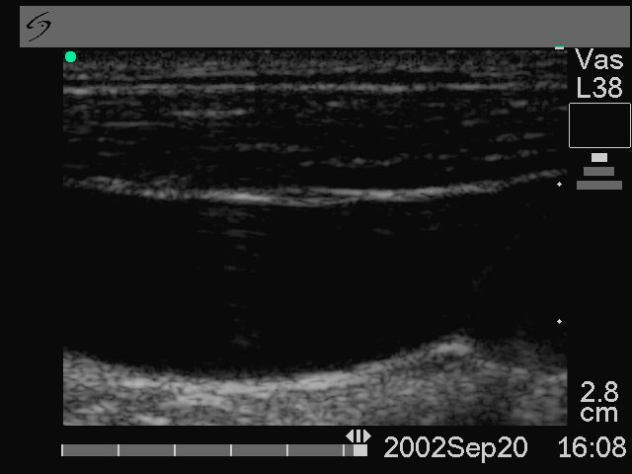
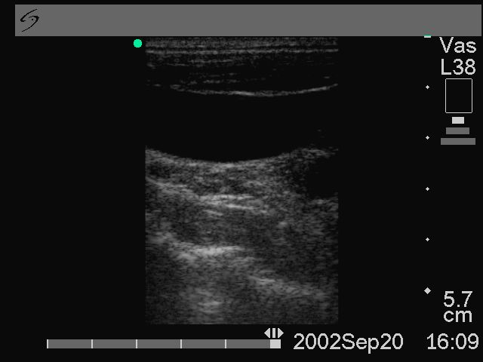
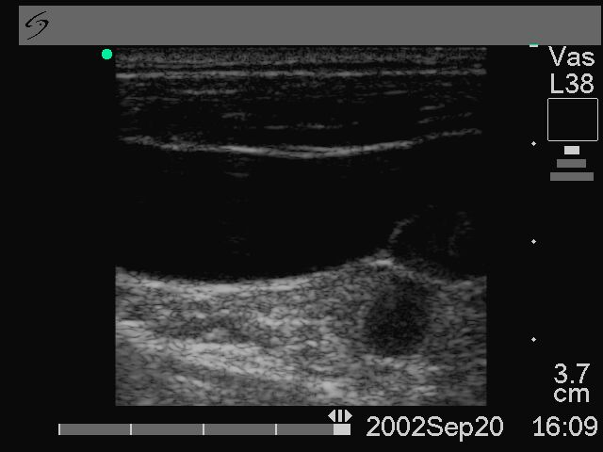
Ultrasound Guidance for Venous Access
Depth
The choice of correct depth setting is a trade-off between achieving adequate field of view to resolve all relevant structures and maximising detail resolution.
Too Close
Too Far
Just Right

Slide 28
Ultrasound Guidance for Venous Access
Conclusion
You need an understanding of ultrasound physics to help with:
  Transducer selection
  Gain, Depth and Frequency Settings
  Ultrasound modes
  Describing tissue Echo Characteristics

Slide 29
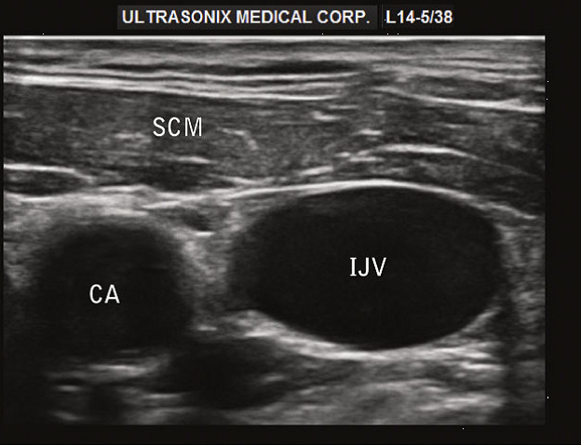
Ultrasound Guidance for Venous Access
Ultrasound Anatomy

Slide 30
Ultrasound Guidance for Venous Access
Objectives
Identify major vascular structures related to vascular access device type
Identify the preferred access vessel for access location

Slide 31
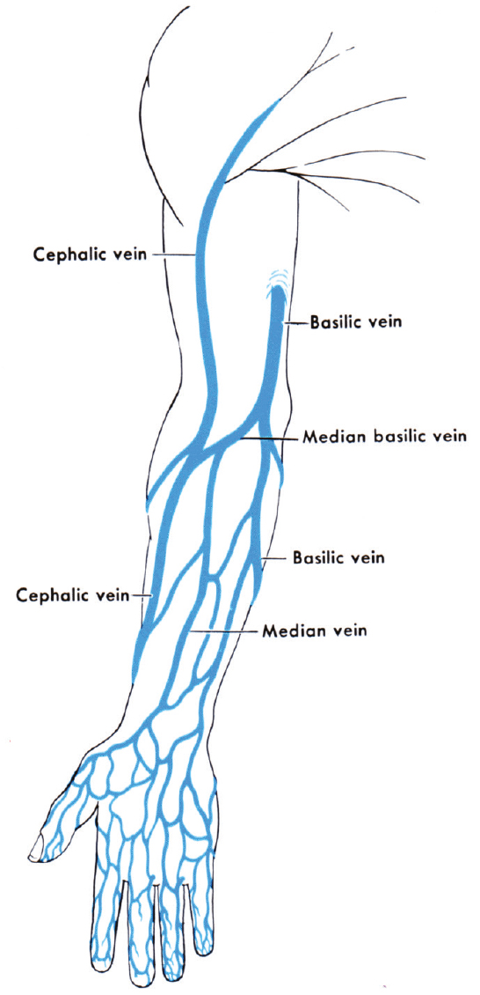
Ultrasound Guidance for Venous Access
Applied Anatomy and Physiology
Basilic vein:
Preferred vein as it provides the most direct route. Blood flow is greater than the cephalic.
Cephalic vein:
secondary choice as the route is more tortuous.
Veins of the ACF should be avoided as patient movement is restricted and catheter damage may occur.
Brachial Vein: Ultrasound guidance

Slide 32
Ultrasound Guidance for Venous Access
Basilic Vein
The basilic vein is the first choice for insertion
Originates on the ulnar or medial side of the forearm and ascends on the posterior surface of the arm.
Just before reaching the elbow, it travels to the front of the arm where it joins the median cubital vein.
The basilic vein joins the brachial vein becoming the axillary vein near the armpit.

Slide 33
Ultrasound Guidance for Venous Access
So...
How do we identify these on Ultrasound?

Slide 34
Ultrasound Guidance for Venous Access
Characteristics of Arteries & Veins
 | Vein | Artery
Appearance | Black | Black
Movement | None ??? | Pulsating
Compressibility | Yes | No
Valves | Yes | No
Size | Usually larger than artery | Usually smaller / rounder

Slide 35
Ultrasound Guidance for Venous Access
Thrombosis
White appearance
Usually non compressible
? CPD

Slide 36
Ultrasound Guidance for Venous Access
Ready to go!

Slide 37
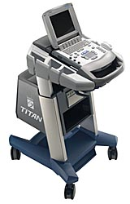
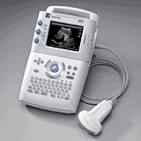
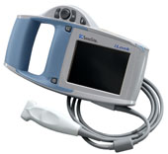
Ultrasound Guidance for Venous Access

Slide 38
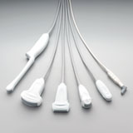
Ultrasound Guidance for Venous Access
Transducers
Transducers
Linear
Small footprint
5-10 MHz

Slide 39
Ultrasound Guidance for Venous Access
Getting the best image
2D greyscale image
Depth/ Focal zone/Gain
Spectral Doppler
 Colour Doppler

Slide 40
Ultrasound Guidance for Venous Access
Venous Access Using US
Prepare patient and scanner
Use surgical ANTT:
Full barrier precautions: Gown, sterile gloves, Cap, Mask
Sterile probe cover / Sterile gel
Patient fully draped with fenestration at insertion site
Chlorhexidine 2% in 70% alcohol in single use applicator

Slide 41
Ultrasound Guidance for Venous Access
Preparing the Probe
Ensure air free coupling between all surfaces

Slide 42
Ultrasound Guidance for Venous Access
Seek out the needle tip
Tilt & Slide the probe to seek out the needle tip.
If you can’t see the tip stop
Work slowly!

Slide 43
Ultrasound Guidance for Venous Access
Hold probe correctly
Take control of the probe
Stabilise your hand
Have a cup of tea!

Slide 44
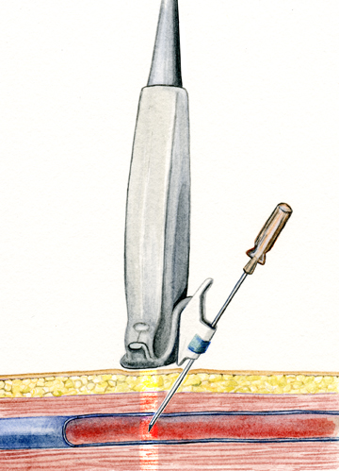
Ultrasound Guidance for Venous Access
Puncture at steep angle
60º-65º
Relative to the skin
Vessel puncture must
take place in the US beam!
Ultrasound
Probe
Ultrasound Beam
1mm wide

Slide 45
Ultrasound Guidance for Venous Access
Vessel puncture
Scan and get target vein in the centre of the screen (ensure that it is compressible)
Place needle in the centre of the probe
Insert needle slowly
Observe vessel wall and look for needle tip prior to puncture
Vessel wall will compress as needle approaches
Stop when needle tip enters vein

Slide 46
Ultrasound Guidance for Venous Access
Common mistakes
Watching hands instead of screen
Holding ultrasound probe incorrectly
Collapsing vein with probe pressure
Puncturing at wrong angle

Slide 47
Ultrasound Guidance for Venous Access
Next Steps
Routine use of U/S
Familiarise yourself with U/S use and identification of anatomy only
Familiarise yourself with controls
Continue use of phantoms until confident
? Venous access service / radiologists for supervision / support

Slide 48
Ultrasound Guidance for Venous Access
It’s not all rosy ☹
This patient endured about 30 attempts at ultrasound-guided PICC placement before he said ‘NO MORE!.’
Photo shows about 20 attempts on right upper arm; about 10 more were on the left.
Sent by ambulance (90 miles each way) to a VAS.
PICC placed on first attempt by a vascular access nurse.

Slide 49
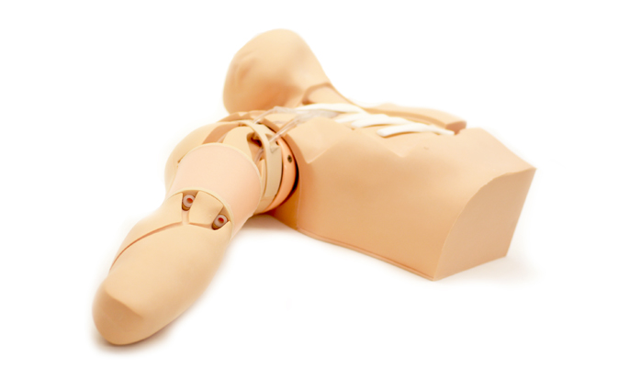
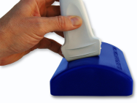
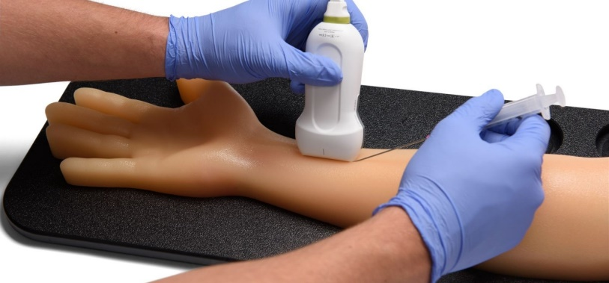
Ultrasound Guidance for Venous Access
Practice!!

