Slide 1
Care and Maintenance of Vascular Access Devices

Slide 2
Care and Maintenance of Vascular Access Devices
Aims of Session
To provide an opportunity to:
Develop knowledge and skills required for safe management of Venous Access Devices (VADs).
Competency Book
Videos

Slide 3
Care and Maintenance of Vascular Access Devices
Learning Outcomes
At the end of the session the nurse will be able to:
Demonstrate an understanding of the various Vascular Access Devices
Demonstrate an understanding of all aspects of caring for a patient with a Vascular Access Device in situ
Discuss the potential complications associated with Vascular Access Devices
Explain the nursing care and management required to alleviate and minimise or prevent complications.

Slide 4
Care and Maintenance of Vascular Access Devices
IV Therapy
Intravenous (I.V.) therapy has become a vital component in patient care and it is estimated that the majority of patients admitted to any hospital in the United Kingdom will receive an I.V. device during their hospital stay each year. (Alexandrou, 2016).

Slide 5
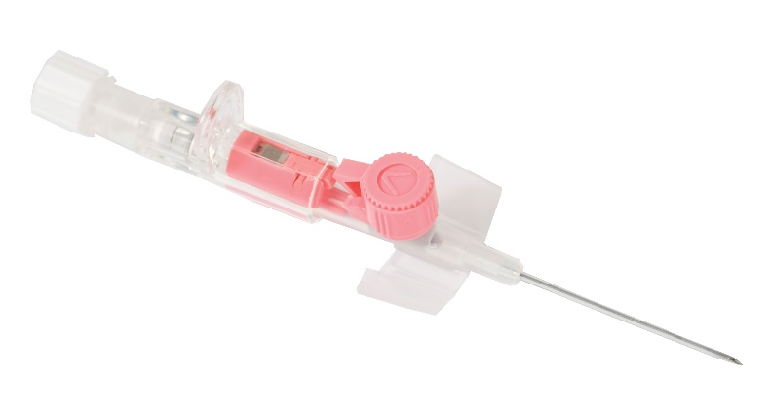
Care and Maintenance of Vascular Access Devices
Current IV Practice
Short peripheral IV cannula:
Effects of prolonged IV therapy using peripheral cannula
Effects of repeated prolonged cannulation
Delay in treatment and cost of delayed long term device placement
Vessel Health and Preservation.

Slide 6
Care and Maintenance of Vascular Access Devices
“plunging a needle directly into a vein can be accomplished with perfect ease and safety under proper aseptic precautions, so that no scar or mark of any kind is left to indicate the site of injection…”.
Dutton, W.F. (1924) Intravenous therapy; Its Application in the modern practice of medicine. Philadelphia, PA: FA Davis

Slide 7
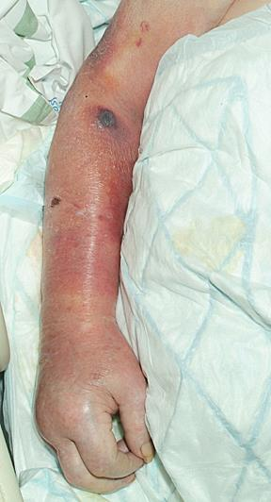
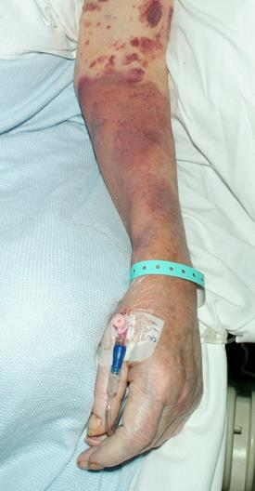
Care and Maintenance of Vascular Access Devices

Slide 8
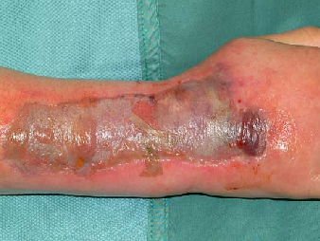
Care and Maintenance of Vascular Access Devices

Slide 9
Care and Maintenance of Vascular Access Devices

Slide 10
Care and Maintenance of Vascular Access Devices

Slide 11
Care and Maintenance of Vascular Access Devices

Slide 12
Care and Maintenance of Vascular Access Devices

Slide 13
Care and Maintenance of Vascular Access Devices
What is a Midline
Midline devices are small catheters which are threaded through a peripheral (cephalic/ basilic/ brachial) vein with terminal tip before the axiliary vein.

Slide 14
Care and Maintenance of Vascular Access Devices
Midlines
Indications
Extended duration of intravenous therapy (5 days or longer)
Poor venous access
Contraindications
Mastectomy on side of insertion (risk of ipsilateral lymphedema)
Arterio – venous fistula on side of insertion

Slide 15
Care and Maintenance of Vascular Access Devices
Central Venous Access
Required when your patient requires:
Treatment not suitable for peripheral administration
Patient preference

Slide 16
Care and Maintenance of Vascular Access Devices
Central Venous Catheter
Tip of catheter terminates in a large central vein (SVC, SVC/RA Junction, IVC or RA)
Central or Acute Central Venous Catheter
PICC
Tunnelled Cuffed Catheter
Totally Implanted Port

Slide 17
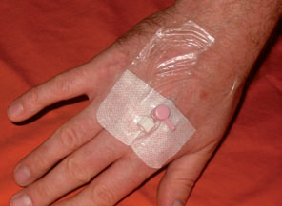
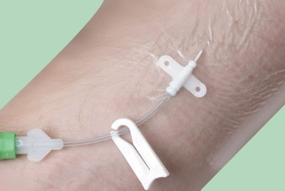
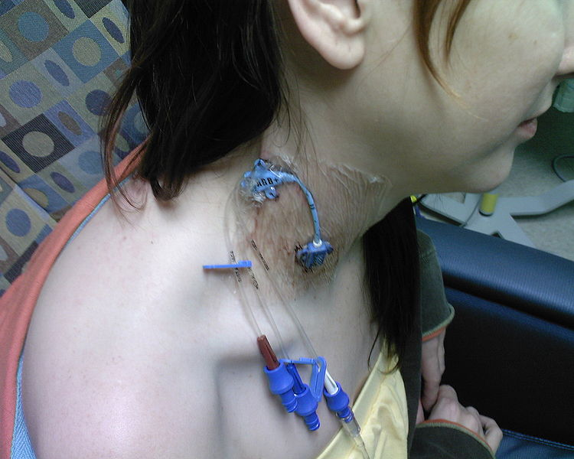
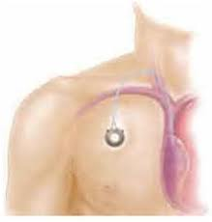
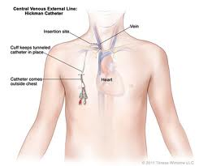
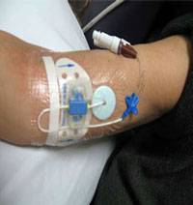
Care and Maintenance of Vascular Access Devices
Types of Vascular Access Devices

Slide 18
Care and Maintenance of Vascular Access Devices
What influences your choice of vascular access device?
Duration and type of therapy
Monitor central venous pressure (PICC)
Volume of therapy
Administration of vesicants / high osmolarity / TPN
Appropriate availability of access
Experience available to insert and care for devices
Patient preference.

Slide 19
Care and Maintenance of Vascular Access Devices
Choice of vascular access device: ensuring the best outcome
Selection of the right device inserted into the right location is paramount to optimum vessel health and reducing complications, specifically infections.
Select the:
Right device
Right location
Right duration

Slide 20
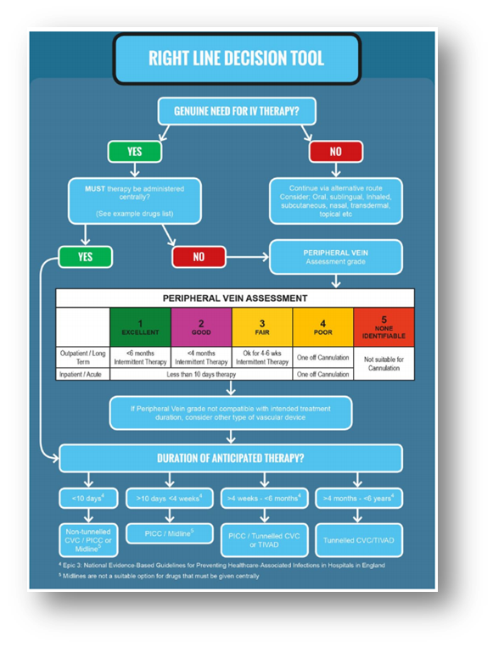
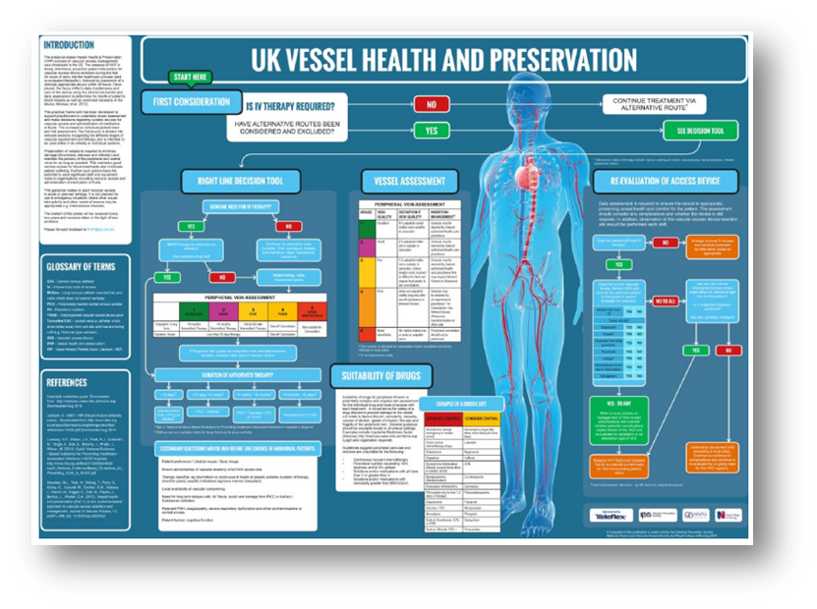
Care and Maintenance of Vascular Access Devices
Catheter Selection Guide

Slide 21
Care and Maintenance of Vascular Access Devices
Device Classification
Depending on its Intended Purpose, a medical device may be classified as Class I (including Is & Im), Class IIa, IIb and III, with Class III covering the highest risk products. The higher the classification the greater the level of assessment required. All Class Is, Im, IIa, IIb and III medical devices require the intervention of third party, the so-called Notified Body.
Classification of a medical device will depend upon a series of factors, including how long the device is intended to be in continuous use
Whether or not the device is invasive or surgically invasive,
Whether the device is implantable or active
Whether or not the device contains a substance, which in its own right is considered to be a medicinal substance and has action ancillary to that of the device.
The classification rules are set out in Annex IX of the directive. This annex includes definitions of the terminology used in the classification rules.

Slide 22
Care and Maintenance of Vascular Access Devices
CVAD complications
Infection
Occlusion
Thrombosis
Phlebitis
Catheter fracture
Catheter migration
Good care and maintenance vital

Slide 23
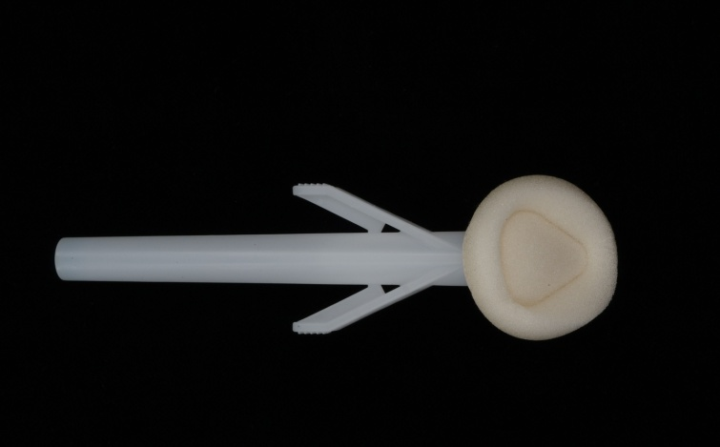
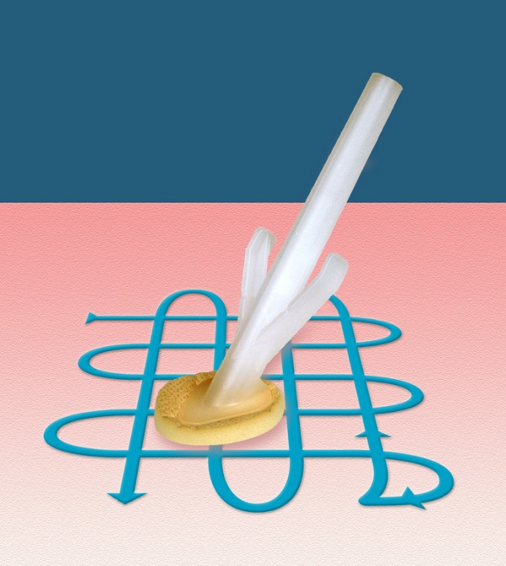
Care and Maintenance of Vascular Access Devices
Cutaneous Antisepsis
Skin antisepsis is regarded as one of the most important measures for preventing catheter related infections
EPIC recommend use of 2% Chlorhexidine Gluconate in 70% Isopropyl Alcohol

Slide 24
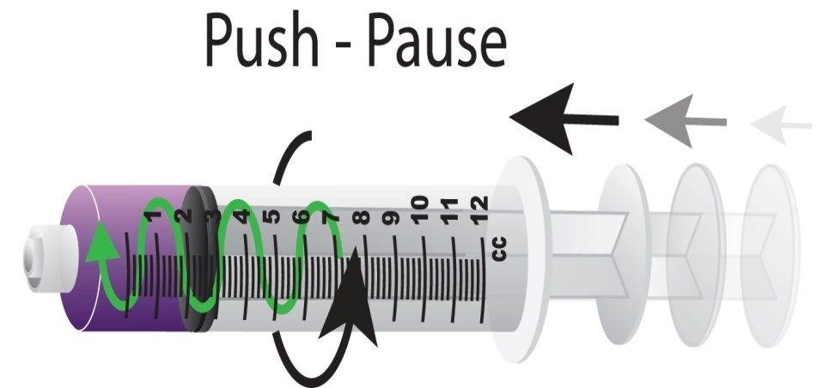
Care and Maintenance of Vascular Access Devices
Flushing
Weekly flush with saline (10mls per lumen)
10ml syringe
Heparin 10 units per ml (2mls per lumen) to complete (If appropriate – valved catheters)
Port -5mls or 3mls 100 units / ml heparin (or follow hospital /manufacturer guidance)
Port – monthly flushing
Use a push pause / stop start turbulent positive pressure flush – This will be demonstrated in the workshop

Slide 25
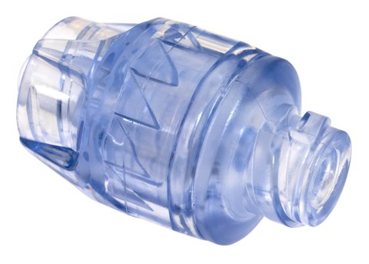
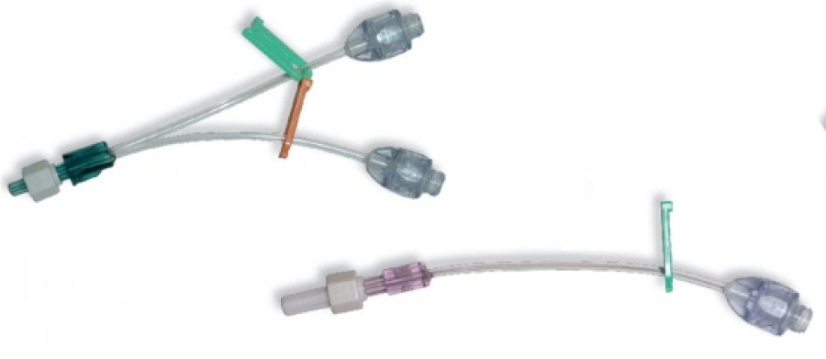
Care and Maintenance of Vascular Access Devices
Closed IV needle free connectors
Various types
Helps to reduce infection, needle stick injuries and blood spillage
Positive, negative, neutral
Clear
No moving parts
Easy to clean
3 or 7 day device
Lipids / bloods

Slide 26
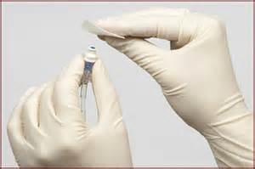
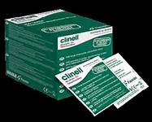
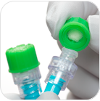
Care and Maintenance of Vascular Access Devices
Scrub the Hub!
ACTIVE
Chlorhexidine and alcohol or alcohol
At least 15 seconds
Allow to dry
PASSIVE
Curos cap

Slide 27
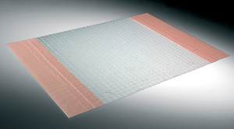
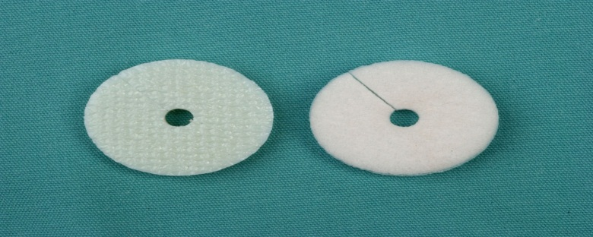
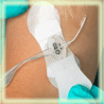
Care and Maintenance of Vascular Access Devices
General Care
Weekly dressing change
Weekly change of Biopatch, or Tegaderm CHG (if used)
Weekly Change Vadsite / bionnector
Smartsite – 3 day change
Weekly Change of Securement device

Slide 28
Care and Maintenance of Vascular Access Devices
Care Continued
Antibiotics and TPN should not be administered via same lumen.
Dedicated single lumen TPN line if appropriate
Liaise with pharmacy re drug compatibility
Measure PICC length following care and maintenance
Document care

Slide 29
Care and Maintenance of Vascular Access Devices
Blood Sampling
The presence of a CVAD makes this procedure easier.
Always follow your local policy
Remove contents of lumen
Use of a vacuum system (adapter required)
Always adequately flush the catheter using a push / pause turbulent flush following blood draws.

Slide 30
Care and Maintenance of Vascular Access Devices
Complications
Infection
Thrombotic

Slide 31
Care and Maintenance of Vascular Access Devices
Risk Factors and Infection Rates
Every intravascular device confers a risk of infection:
Type of catheter used
Method of insertion
Site of insertion
Level of aseptic technique
Site care
Number of manipulations
Specific host factors

Slide 32
Care and Maintenance of Vascular Access Devices
Sources of micro organisms causing CRI’s

Slide 33
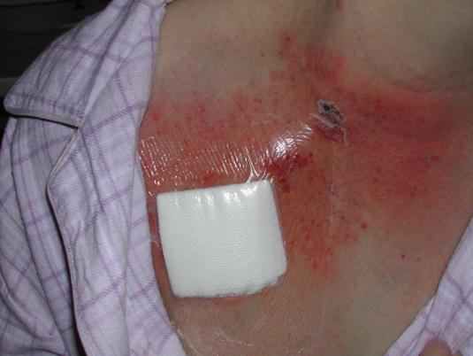
Care and Maintenance of Vascular Access Devices
Infection
Local Exit Site Associated with:
Redness
Swelling
Tenderness
Tunnel Infection Associated with:
Redness
Swelling,
Tenderness over tunnel
Intermittent or chronic purulent or bloody drainage

Slide 34
Care and Maintenance of Vascular Access Devices
Systemic Infection
Signs and symptoms of CRBSI
Fever > 38 degrees centigrade
Rigors/shakes, especially after flushing, vomiting, back pain
BSI is considered to be associated with the CVC if it was used during 48 hours before the development of the BSI.
To confirm a catheter-related BSI
2 positive blood cultures with the same organism must be obtained from at least 2 separate sites at different times (from the line and peripheral)
Administer the appropriate antibiotic.
Line removal if the patient unwell.

Slide 35
Care and Maintenance of Vascular Access Devices
Occlusion
Non-Thrombotic Occlusion
Lipid accumulation
Drug precipitation
Kinks, Clamps on
Catheter may be completely blocked
Thrombotic Occlusion
Thrombosis (look for signs of raised collateral vessels)
Management
Refer for thrombolysis treatment

Slide 36
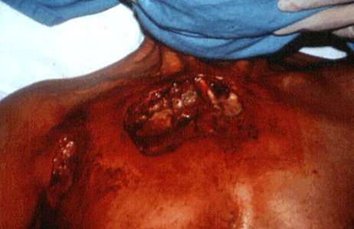
Care and Maintenance of Vascular Access Devices
Fibrin Sheath – Persistent Withdrawal Occlusion
Line fails to aspirate but takes flush with no resistance
Instil Urokinase 5000 units in 2mls and leave for one hour (may be repeated a second time)
Remember extravasation does not only occur in the peripheral veins!!

Slide 37
Care and Maintenance of Vascular Access Devices
Catheter misplacement
Never use a line unless tip position has been verified on x-ray
Suspect if :
Cuff visible
Lengthening of external catheter
Chest wall swelling on infusion
Management
Inform medical staff
Obtain CXR
Do not use line
Dougherty & Lamb (2004)

Slide 38
Care and Maintenance of Vascular Access Devices
Care Bundles
Improved clinical outcomes
Reduced morbidity
Fewer adverse events
Reduce variation in clinical care
Most important statement: Remove when no longer required!

Slide 39
Care and Maintenance of Vascular Access Devices
The future of IV therapy
Intravenous (I.V.) therapy has become a vital component in patient care and it is estimated that the majority of patients admitted to any hospital in the United Kingdom will receive an I.V. device during their hospital stay each year, (Peterson 2002).
We need to ensure patient safety with regard to patients vessel health.

Slide 40
Care and Maintenance of Vascular Access Devices
Further Reading
EPIC 3 Guidelines 2014
Health Protection Scotland Guidelines 2013
INS guidelines
RCN infusion standards

