Slide 1
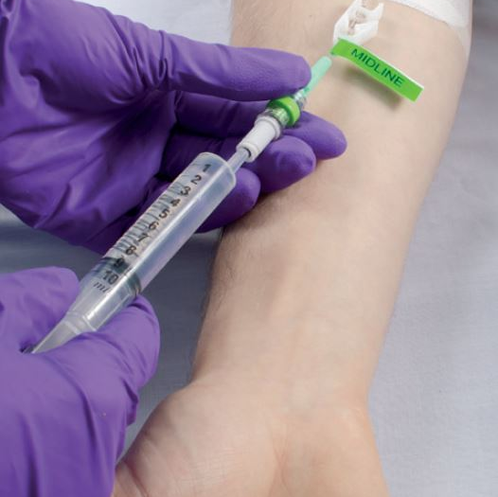

Peripherally Inserted Central Catheter (PICC) Insertion

Slide 2
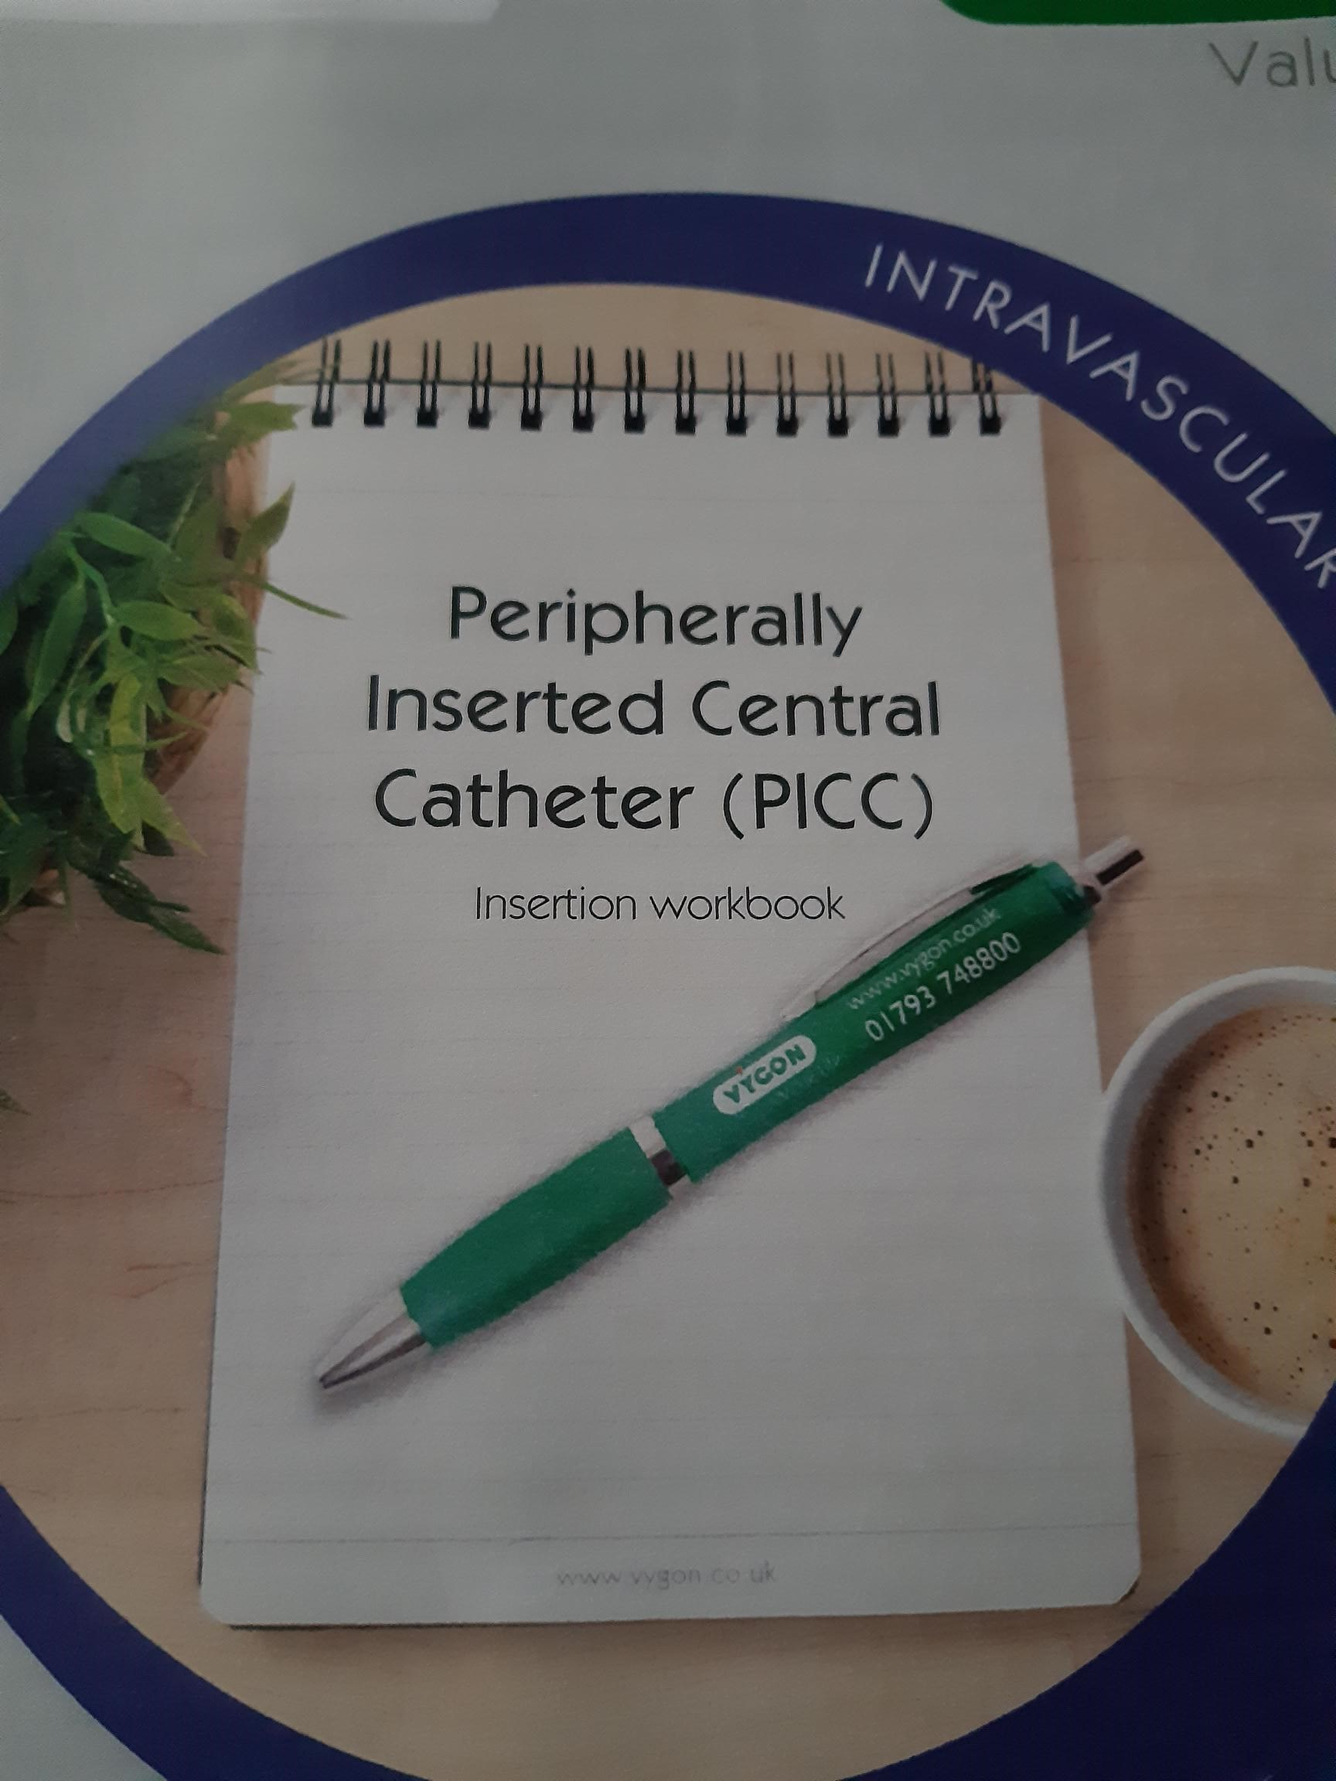
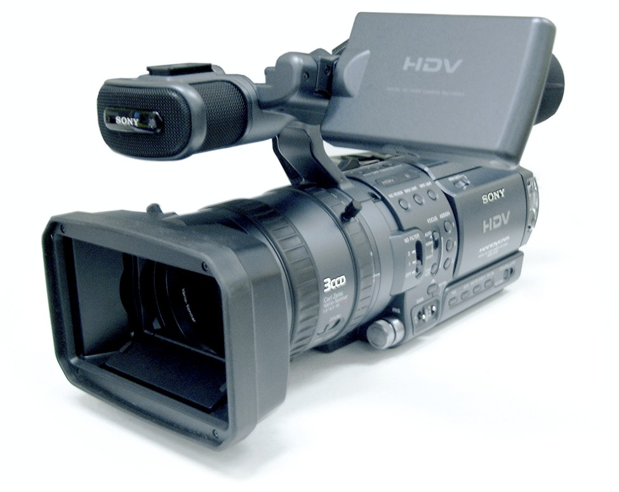

PICC Insertion
To be used in conjunction with

Slide 3
PICC Insertion
Course Objectives
At the end of the course you should be able to:
Demonstrate a knowledge of the anatomy and physiology as related to PICC insertion.
Identify preferred veins for PICC insertion
Overview of ultrasound guidance
Understand of the procedure of PICC insertion
Describe potential complications of PICC insertion, how to recognise them and interventions should they occur.

Slide 4
PICC Insertion
Device Selection
Consider:
Proposed duration of IV therapy
Infusates properties
Patient factors

Slide 5
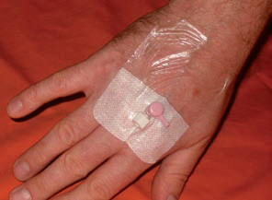
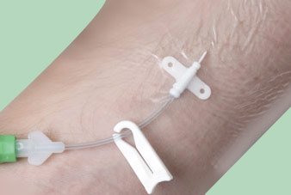
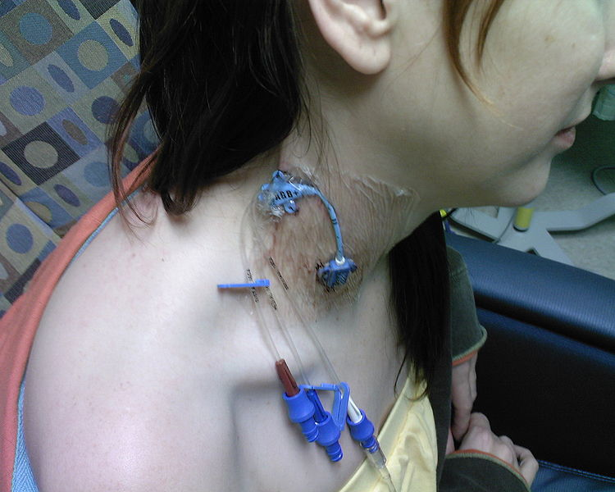
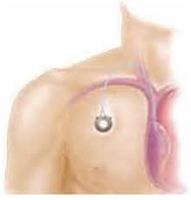
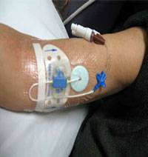
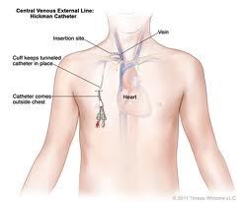
PICC Insertion
Types of Vascular Access Devices

Slide 6
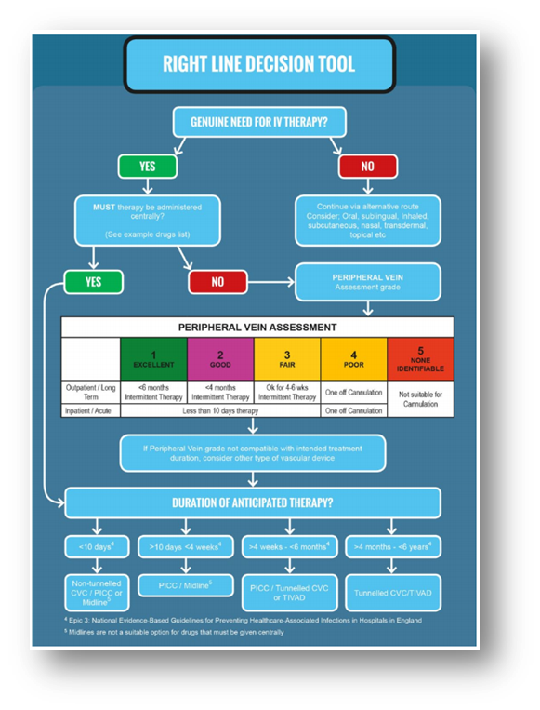

PICC Insertion
Catheter Selection Guide

Slide 7
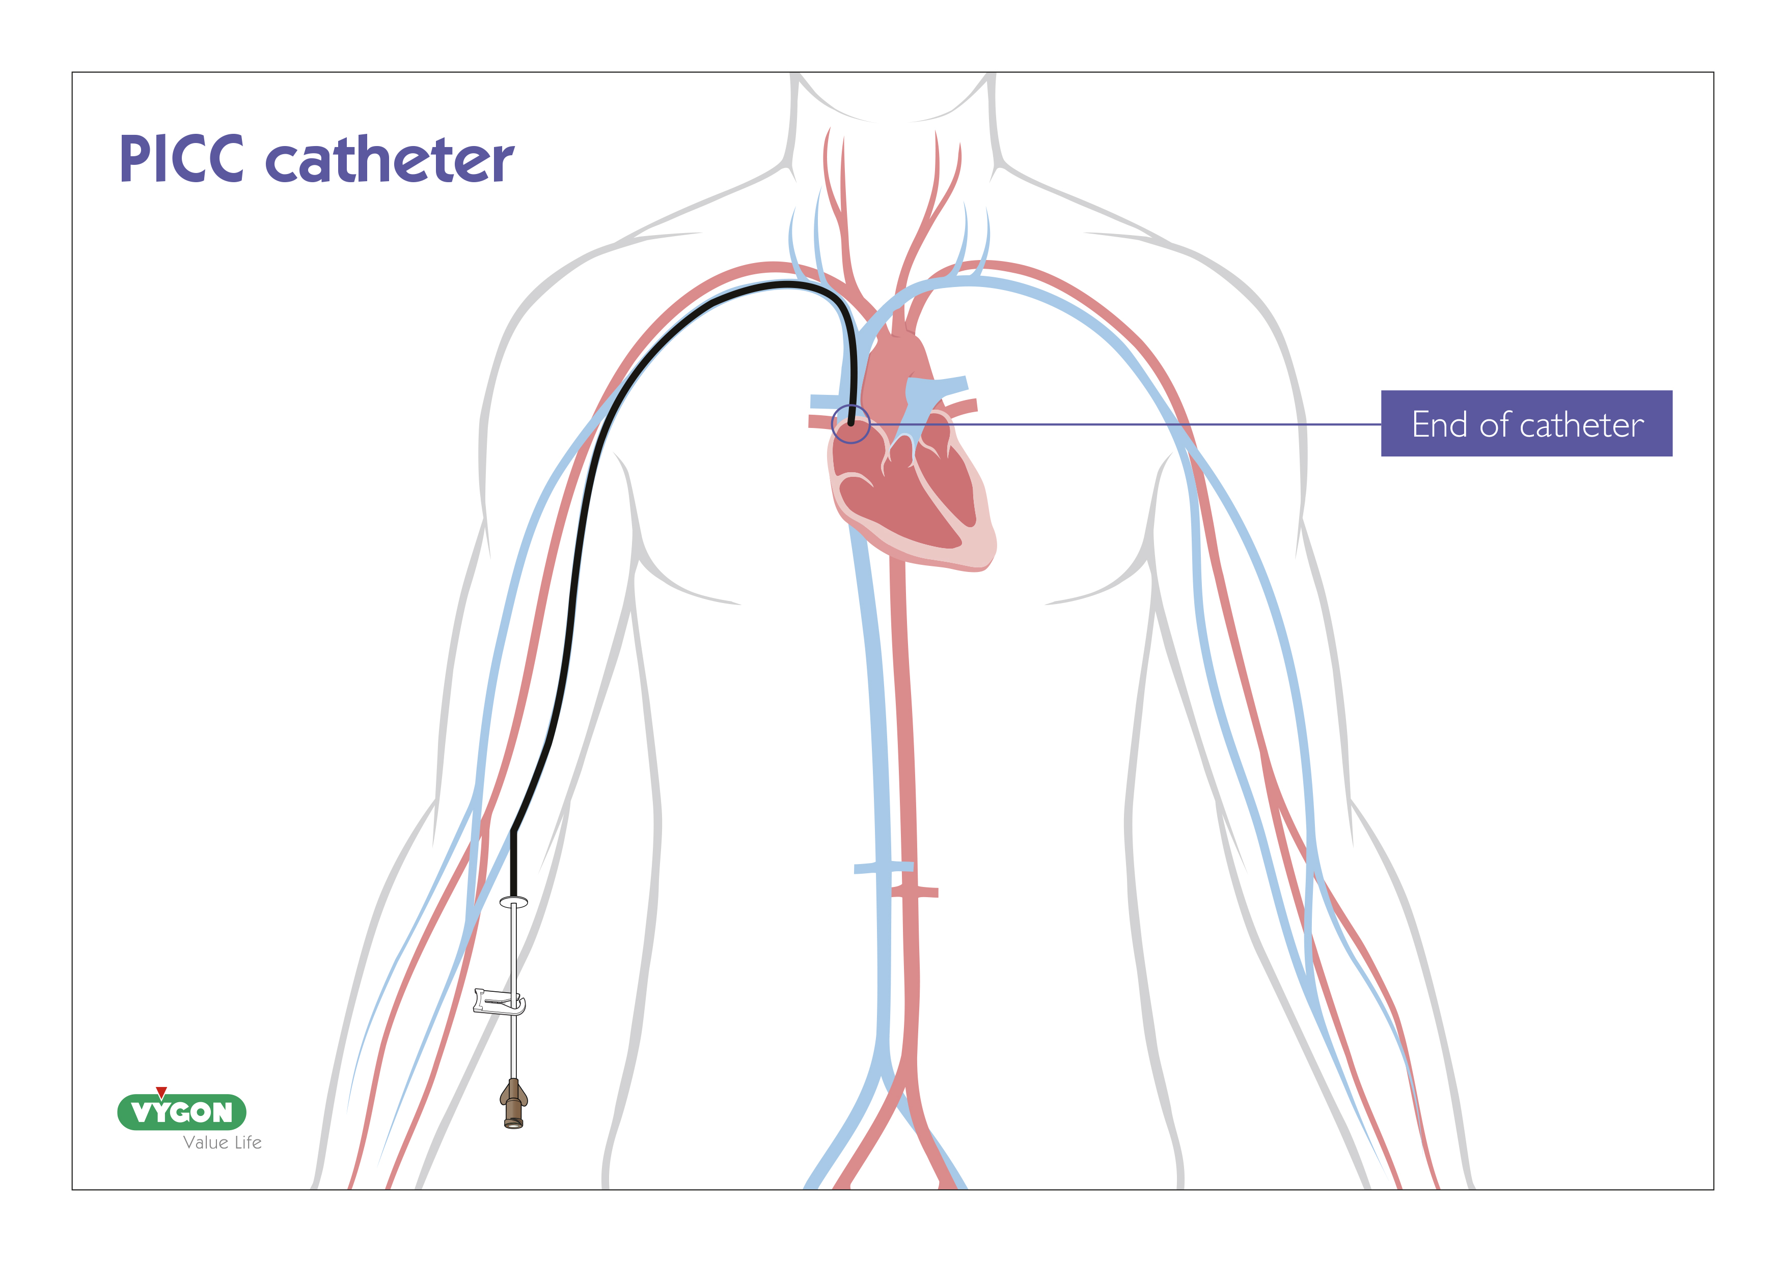
PICC Insertion
What is a PICC
Peripherally Inserted Central Catheter
Manufactured from silicone or polyurethane. Usually 50 – 60cms
Ideal for patients requiring long term IV therapy
Typically inserted via the peripheral veins of the upper arm
Can be inserted via the femoral vein
Tip terminates in one of the large central veins (Lower SVC, SVC / right atrial junction or upper right atrium)

Slide 8
PICC Insertion
Benefits of PICCs
Safe and convenient to insert
  Can be placed at the bedside or in treatment rooms
Cost effective
Reduces repeated cannulations
  Can remain in place for the whole treatment period
Preservers delicate peripheral veins
Step down device

Slide 9

PICC Insertion
Indications
IV infusates not compatible with peripheral infusion
Extended length of treatment
Poor venous access

Slide 10

PICC Insertion
Contraindications
Previous mastectomy and lymph node clearance on intended side of insertion (risk of lymphodema)
If patients have advanced CKD, discussions should take place with nephrologists prior to insertion

Slide 11
PICC Insertion
PICC use
Length and type of therapy are the key considerations Including:
  Infusions of vesicants, irritant or hyperosmolar infusions
  Parenteral Nutrition
  Antibiotics
  Pain Relief
  I.V. Fluids
  Blood/Blood Products/Blood Sampling
  Infusion Device

Slide 12
PICC Insertion
PICC insertion using ultrasound guidance

Slide 13
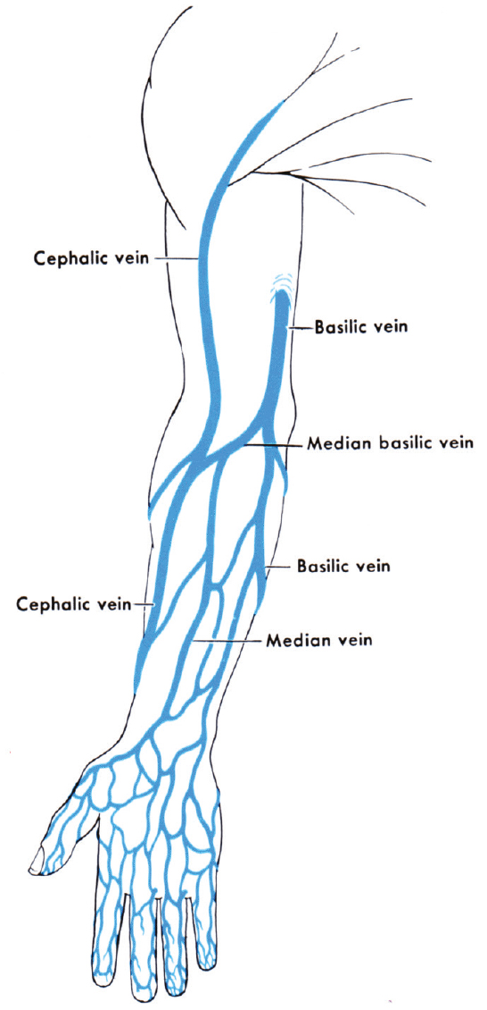
PICC Insertion
Applied anatomy and physiology
Basilic vein:
Preferred vein as it provides the most direct route. Blood flow is greater than the cephalic.
Cephalic vein:
secondary choice as the route is more tortuous.
Veins of the ACF should be avoided as patient movement is restricted and catheter damage may occur.
Brachial Vein:
Close proximity to brachial artery and nerve bundle
Ultrasound guidance

Slide 14
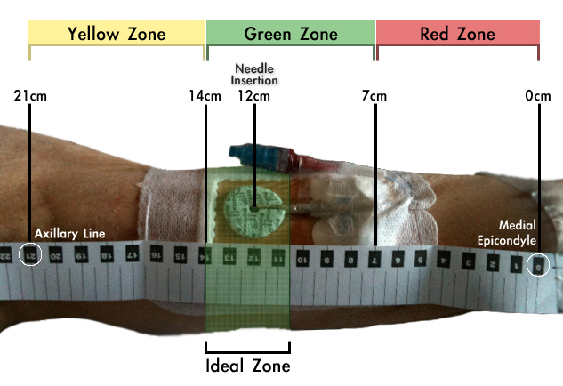
PICC Insertion
ZIM insertion method - Dawson (2015)

Slide 15
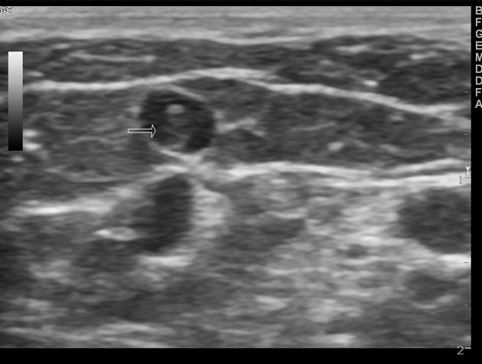
PICC Insertion
Adequate Vein Size
To reduce the risk of thrombosis
The vein to catheter ratio should be around 3:1 or at the minimum 2:1 (Nifong et al 2011, Sharp, 2015, Spencer and Mahoney, 2017)
How can you ensure this?

Slide 16
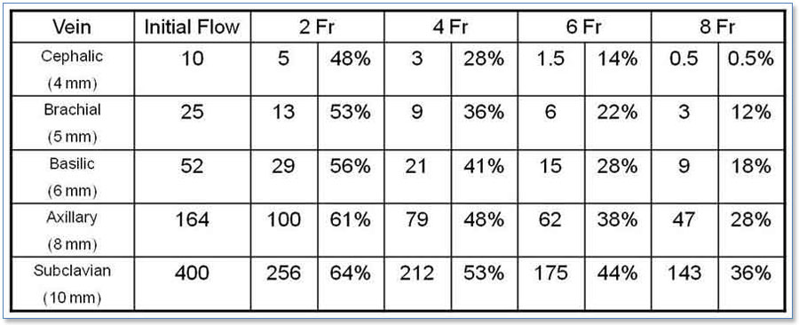
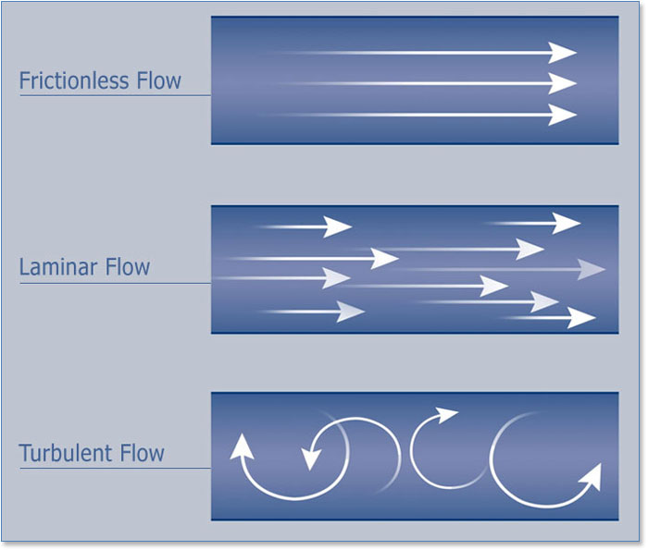
PICC Insertion
Flow Dynamics

Slide 17
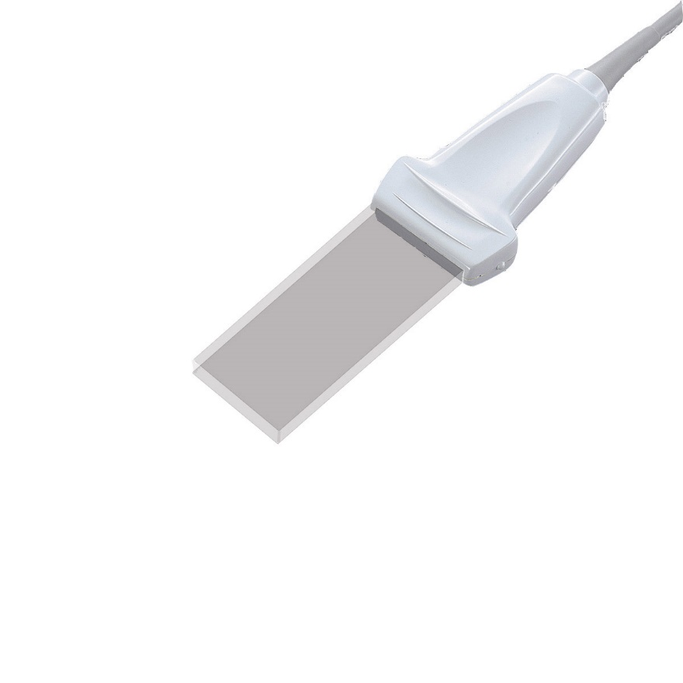
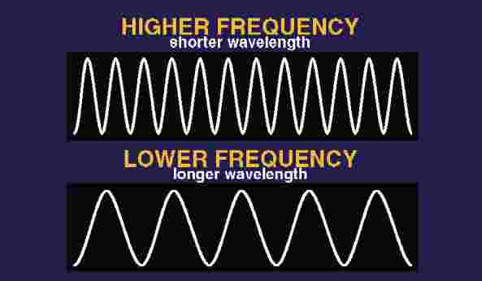
PICC Insertion
Which probe should you chose for vascular access?
Superficial Veins
Don’t need depth
High frequency probe
Linear
Wavelengths close together
Less penetration / higher resolution

Slide 18
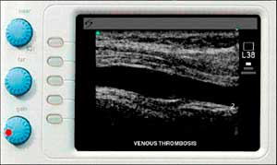
PICC Insertion
Ultrasound Settings (knobology)
 2D greyscale image
 Depth/ Focal zone/Gain
 Spectral Doppler
 Colour Doppler
  Colour Power Doppler (CPD)

Slide 19
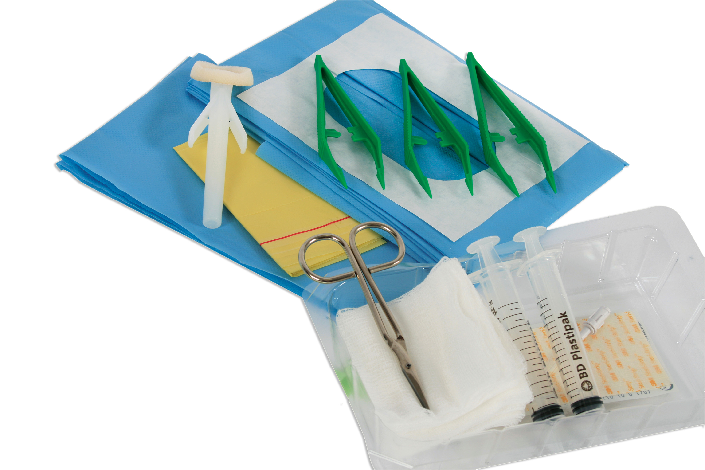
PICC Insertion
Pre – Insertion Preparation
Patient
  Consent
Clinical area, environment
Ensure all equipment available
Assistant if possible
Surgical ANTT
Skin prep (epic III)
Ultrasound machine and probe protection
Consider patient position
Consider a dedicated pack
Documentation

Slide 20

PICC Insertion
Prepare Patient and Trolley
Use surgical ANTT
Full barrier precautions: Gown, sterile gloves, Cap, Mask
Sterile probe cover / Sterile gel
Clean and set trolley, ensure all equipment available
Patient fully draped with fenestration at insertion site
Loveday, 2014

Slide 21
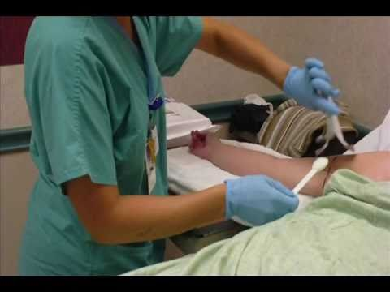
PICC Insertion
Consider Patient Positioning for Device Insertion
  Arm extended to the side - 90⁰ or bent at an angle
  Lying / Sitting
  Tourniquet *

Slide 22
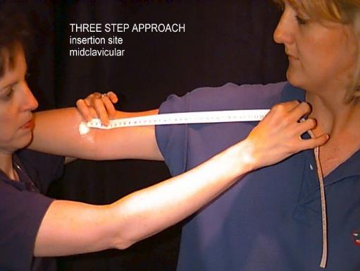
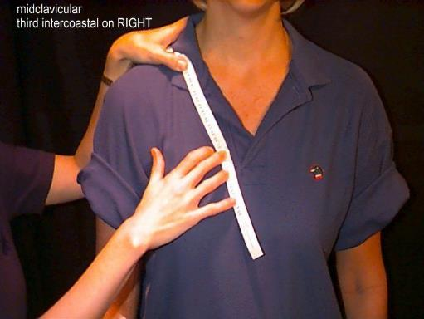
PICC Insertion
Prepare and Trim PICC
Flush catheter through the side arm using 0.9% saline
Measure the catheter using a two or three step approach
  Intended insertion site to (shoulder) then midclavicular
  Midclavicular to third / forth intercostal space
Lum technique (patient height)
Pull back inner obturator and cut catheter to size using a blade or guillotine device (Pettit, 2006)

Slide 23
PICC Insertion
Preparing the Probe
Ensure air free coupling between all surfaces

Slide 24
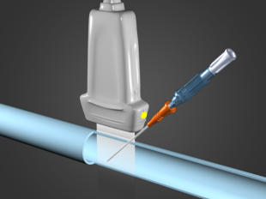
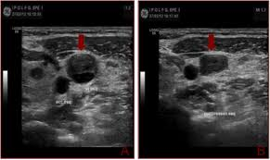
PICC Insertion
Ultrasound guided puncture: Tips
Watch the screen
Scan to find most appropriate vessel
Ensure target vessel is in the centre of the screen
Place needle in the centre of the probe
Slowly advance needle
Observe vessel wall and look for needle tip prior to puncture
Stop when needle enters the centre of the vein
Do not transfix the vein

Slide 25

PICC Insertion
Local Anaethesia
Ensure patient comfort
Local anaesthesia: Lignocaine 1%
Topical and local anaesthesia
If required, consider Oral or IV sedation or conscious sedation

Slide 26
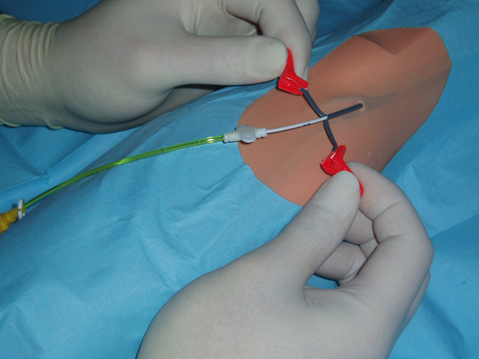
PICC Insertion
Modified Seldinger Technique (MST)
Prepare equipment and trim catheter to size
Vein accessed, wire advanced
Needle removed, peel away sheath advanced over wire.
Wire and dilator is removed and catheter fed through (ensure patient turns head to side of insertion and places chin on chest to prevent IJ cannulation. Advance PICC to SVC/RA
Peel away the sheath
Use ECG technology where available or obtain chest Xray to confirm tip position

Slide 27
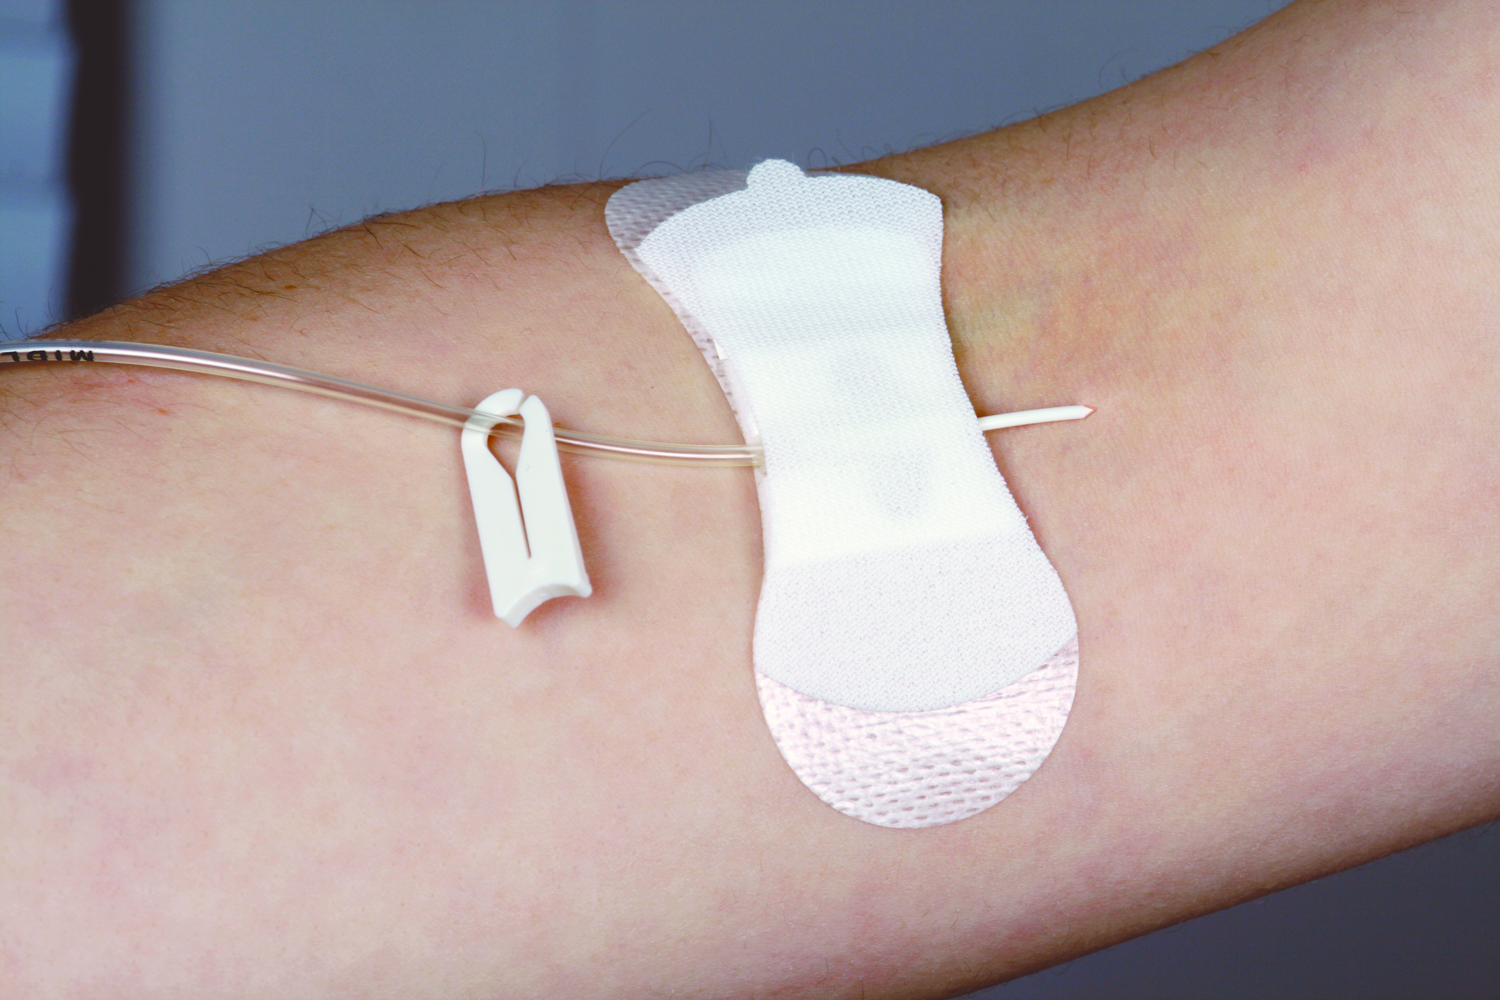

PICC Insertion
Post Insertion Care
Aspirate and flush catheter using a 10ml syringe
Secure with a recognised securement device
Apply a bioclusive dressing
Patient and staff education.
Consider the use of glue to stabilise PICC

Slide 28

PICC Insertion
Potential Complications During PICC Placement
  Arterial puncture
  Hemaetoma
  Air embolism (rare)
  Nerve damage
  Misplacement of the tip
  Difficulty advancing the PICC

Slide 29

PICC Insertion
Documentation
Reason for insertion
Device inserted (length, lumen size etc.)
Access site (vein used)
Number of attempts
Drugs used (local anaesthetic, flush)
Securement device used
Tip position confirmation
Any complications on insertion

Slide 30
PICC Insertion
Video: PICC insertion using ultrasound guidance
https://vimeo.com/414814188

